Slide 2
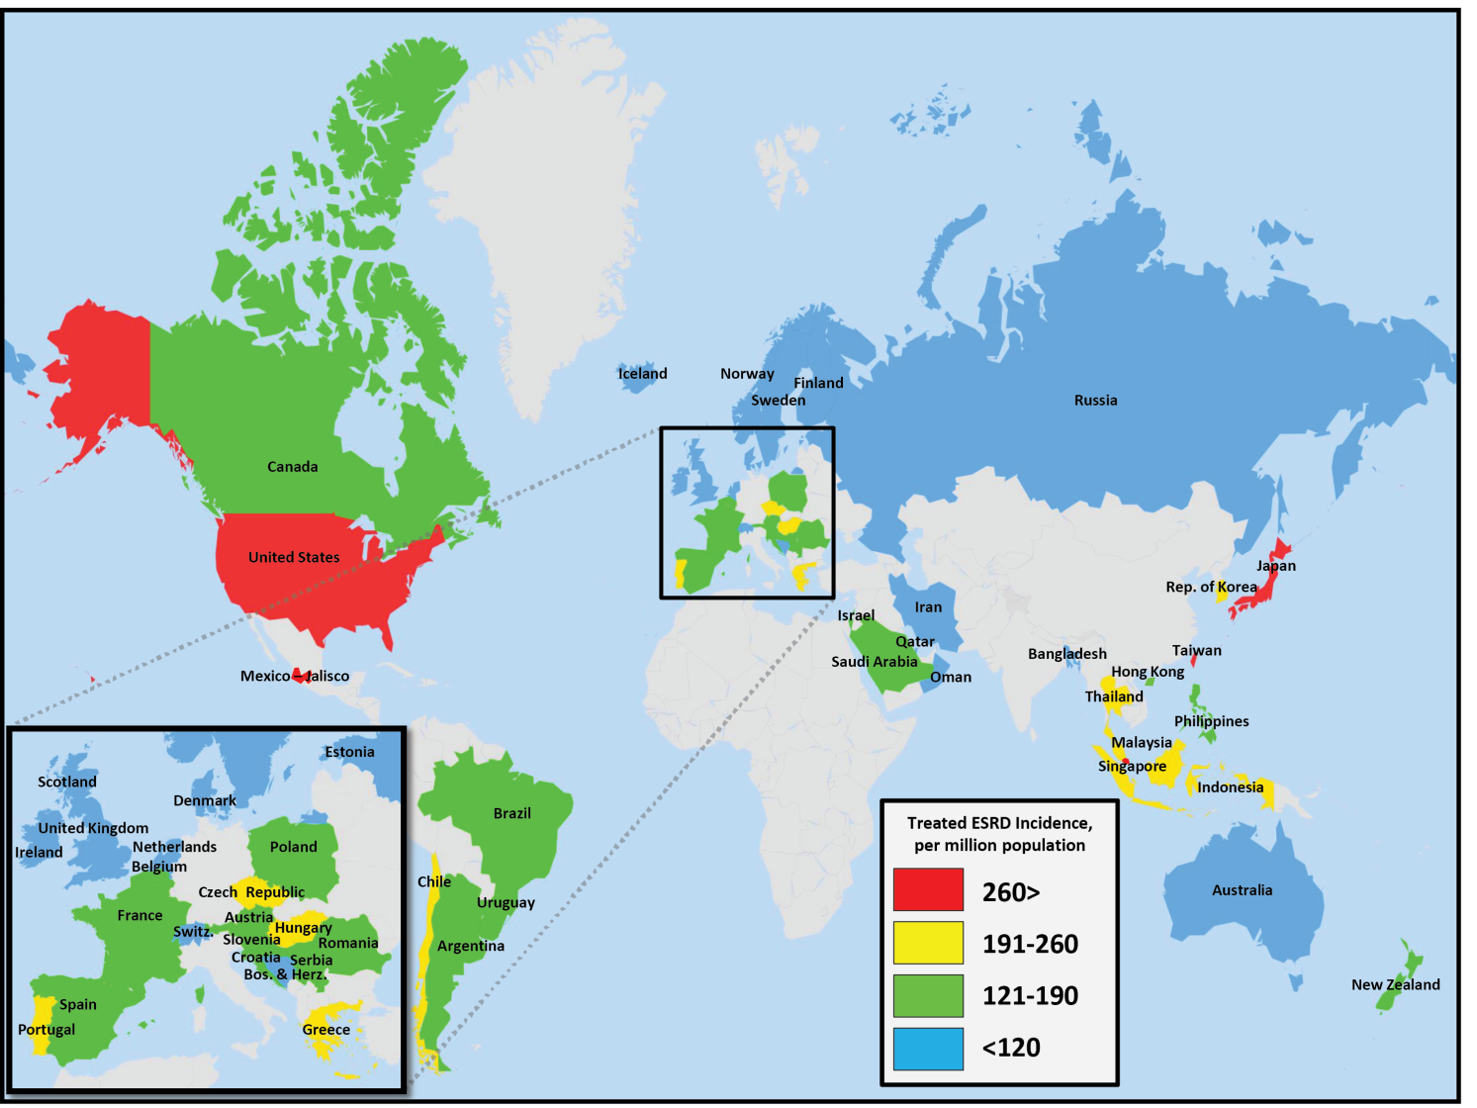
Figure 13.1 Geographic variations in the incidence of treated ESRD
per million population, by country, 2013
Data Source: Special analyses, USRDS ESRD Database. Data presented only for countries from which relevant information was available. All rates are unadjusted. Data for Indonesia represent the West Java region. Data for France include 22 regions. Data for Spain include 18 of 19 regions. Abbreviations: ESRD, end-stage renal disease.

Slide 3
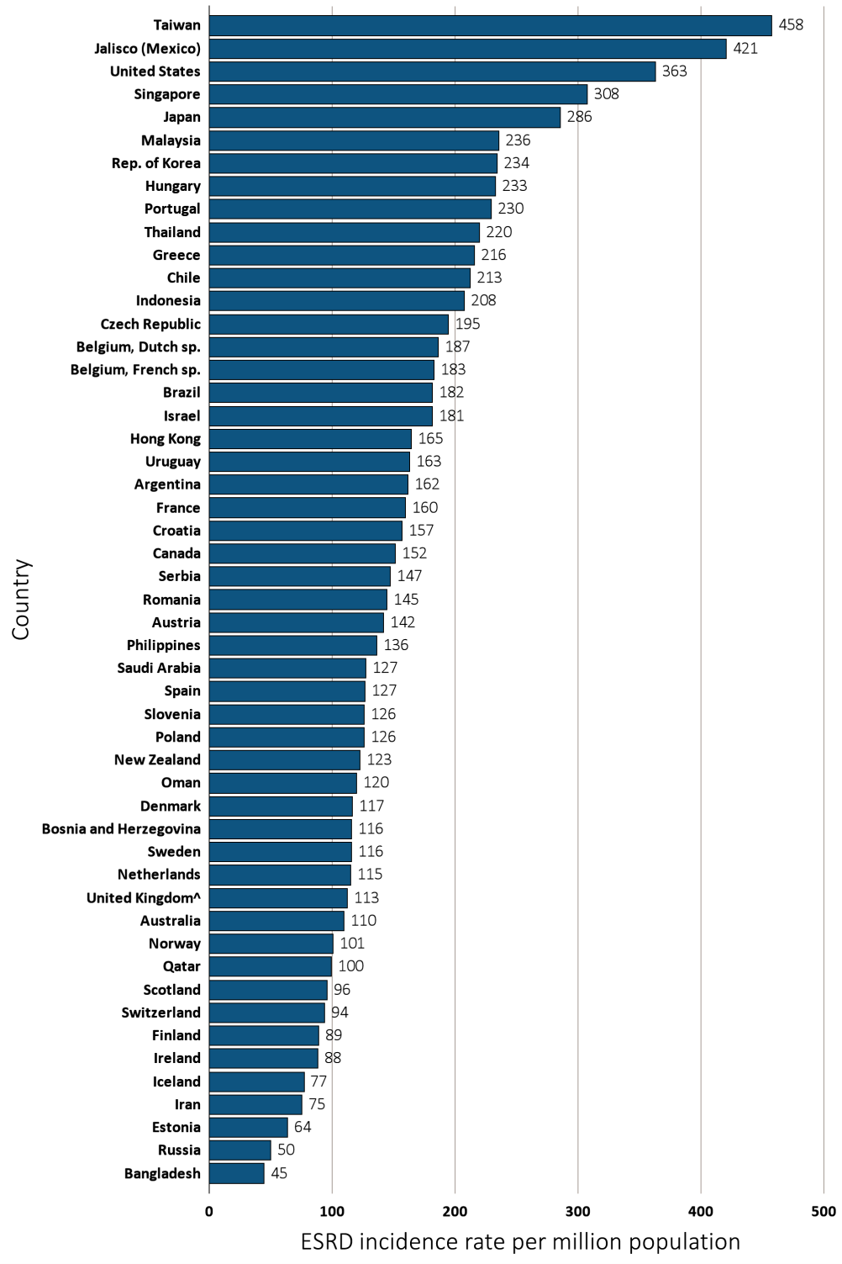
Figure 13.2 Incidence of treated ESRD,
per million population, by country, 2013
Data Source: Special analyses, USRDS ESRD Database. Data presented only for countries from which relevant information was available. All rates are unadjusted. ^United Kingdom: England, Wales, Northern Ireland (Scotland data reported separately). Data for Belgium do not include patients younger than 20. Data for Indonesia represent the West Java region. Data for France include 22 regions. Data for Spain include 18 of 19 regions. Abbreviations: ESRD, end-stage renal disease; sp., speaking.

Slide 4
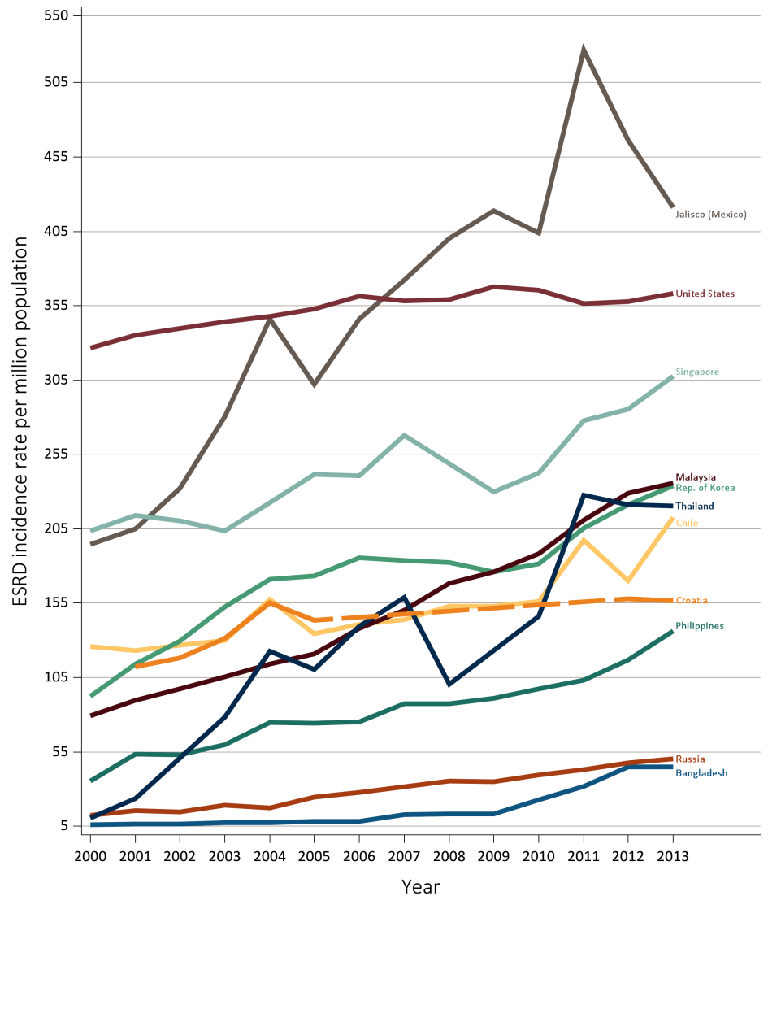
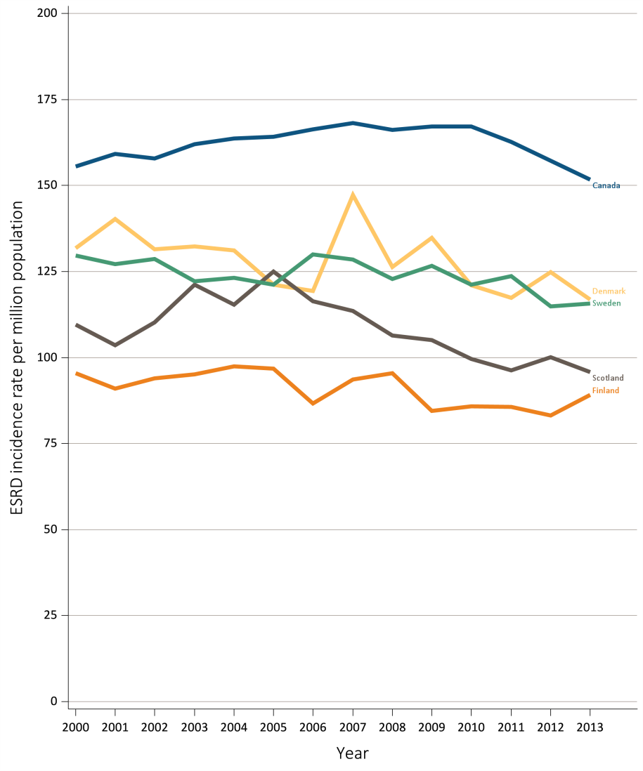
Figure 13.3 Trends in the incidence of treated ESRD,
per million population, by country, 2000-2013
Ten countries having the highest % rise in ESRD incidence rate from 2000/01 to 2012/13, plus the U.S.
Five countries having the largest % decline in ESRD incidence rate from 2000/01 to 2012/13
Data Source: Special analyses, USRDS ESRD Database. All rates are unadjusted. Data for Croatia are missing from 2006-2011, indicated by the dashed line. Data for U.S. are shown for comparison purposes. Abbreviations: ESRD, end-stage renal disease.
Data Source: Special analyses, USRDS ESRD Database. All rates are unadjusted. Abbreviations: ESRD, end-stage renal disease.

Slide 5
Table 13.1 Trends in the incidence of treated ESRD, per million population,
^{by country, 2000-2013}
Country | 2000 | 2001 | 2002 | 2003 | 2004 | 2005 | 2006 | 2007 | 2008 | 2009 | 2010 | 2011 | 2012 | 2013 | % change from 2000/01 to 2012/13
Argentina | . | . | . | . | 137.4 | 140.3 | 141.0 | 151.1 | 144.4 | 152.6 | 151.5 | 151.9 | 156.0 | 162.0 | .
Australia | 91.6 | 98.4 | 96.7 | 99.7 | 96.9 | 112.8 | 117.4 | 113.3 | 120.2 | 112.1 | 106.0 | 112.4 | 113.2 | 110.0 | 17.5
Austria | 132.3 | 137.6 | 135.3 | 140.2 | 160.8 | 153.8 | 159.5 | 154.0 | 149.7 | 150.9 | 139.8 | 141.4 | 143.0 | 141.7 | 5.5
Bahrain | . | . | . | . | . | . | . | . | 206.1 | 205.4 | 219.5 | 207.5 | . | . | .
Bangladesh | 6.1 | 6.2 | 6.4 | 7.5 | 7.1 | 8.3 | 8.3 | 12.9 | 13.1 | 13.4 | 22.8 | 31.5 | 44.9 | 44.7 | 628.5
Belgium, Dutch sp. | 149.3 | 159.8 | 174.0 | 174.8 | 181.4 | 183.1 | 192.4 | 189.8 | 192.6 | 208.8 | 198.4 | 185.3 | 189.6 | 186.5 | 21.7
Belgium, French sp. | . | 176.5 | 172.9 | 160.5 | 186.5 | 176.8 | 187.0 | 187.0 | 191.8 | 195.8 | 191.1 | 186.3 | 190.4 | 182.7 | 5.7
Bosnia and Herzegovina | . | . | . | 106.2 | 107.5 | 103.9 | 132.6 | 150.8 | 149.3 | 143.3 | 133.1 | 122.6 | 125.4 | 116.0 | .
Brazil | . | . | . | . | . | 177.4 | 184.9 | 140.1 | 145.4 | 98.0 | 146.7 | 174.1 | 171.5 | 181.8 | .
Canada | 155.6 | 159.2 | 157.8 | 162.0 | 163.6 | 164.1 | 166.3 | 168.2 | 166.1 | 167.2 | 167.1 | 162.6 | 157.1 | 151.7 | -1.9
Chile | 125.8 | 123.0 | 126.8 | 129.9 | 157.4 | 134.5 | 140.5 | 143.8 | 152.8 | 153.1 | 155.9 | 197.2 | 170.1 | 212.6 | 53.8
Colombia | . | . | . | . | 96.7 | 100.7 | 125.9 | 146.4 | 107.4 | 103.4 | 122.9 | 92.8 | . | . | .
Croatia | . | 112.1 | 118.2 | 131.4 | 155.0 | 143.5 | . | . | . | . | . | . | 158.1 | 156.7 | 40.4
Czech Republic | 150.1 | 162.8 | 159.0 | 167.0 | 166.0 | 174.5 | 185.7 | 184.6 | 181.9 | 180.5 | 197.8 | 171.9 | . | 194.5 | 24.3
Denmark | 131.8 | 140.2 | 131.5 | 132.3 | 131.2 | 121.2 | 119.4 | 147.2 | 126.3 | 134.8 | 121.0 | 117.3 | 124.8 | 116.9 | -11.1
Estonia | . | . | . | . | . | . | . | . | . | . | . | . | . | 63.7 | .
Finland | 95.4 | 91.0 | 94.0 | 95.1 | 97.4 | 96.8 | 86.6 | 93.6 | 95.4 | 84.5 | 85.8 | 85.6 | 83.1 | 89.2 | -7.6
France | . | . | . | . | . | 140.1 | 144.0 | 140.8 | 148.2 | 151.3 | 152.2 | 151.0 | 154.7 | 159.9 | .
Greece | 157.2 | 166.7 | 167.9 | 179.7 | 196.5 | 194.3 | 197.6 | 191.6 | 201.2 | 205.0 | 190.9 | 203.5 | 210.2 | 215.8 | 31.5
Hong Kong | . | 130.8 | 128.8 | 128.2 | 141.2 | 145.1 | 148.9 | 147.4 | 148.2 | 138.5 | 151.2 | 157.7 | 165.6 | 164.5 | 26.2
Hungary | . | . | . | . | . | . | . | . | 235.8 | 264.5 | 228.6 | 241.2 | 234.3 | 233.2 | .
Iceland | 56.9 | 77.2 | 73.0 | 72.5 | 78.7 | 67.4 | 69.1 | 83.7 | 72.5 | 87.9 | 106.9 | 103.4 | 59.2 | 77.2 | 1.7
Indonesia | . | . | . | . | . | . | . | . | . | 100.8 | 128.4 | 176.1 | 194.6 | 207.9 | .
Iran | . | . | . | . | . | . | . | . | 99.2 | 70.2 | 73.7 | 73.5 | 73.6 | 75.2 | .
Ireland | . | . | . | . | . | . | . | . | . | 107.2 | 81.7 | 90.3 | 92.2 | 88.2 | .
Israel | 165.3 | 167.5 | 166.2 | 187.6 | 188.6 | 186.2 | 192.4 | 193.2 | 189.5 | 193.4 | 186.4 | 187.6 | 182.8 | 181.4 | 9.4
Italy | . | . | . | . | . | . | . | . | . | . | 162.0 | . | . | . | .
Jalisco (Mexico) | 194.7 | 204.8 | 231.9 | 280.4 | 346.1 | 302.3 | 345.9 | 372.2 | 400.4 | 419.0 | 403.9 | 527.1 | 466.5 | 420.9 | 122.1
Japan | 241.8 | 251.3 | 256.0 | 263.0 | 266.8 | 270.6 | 275.4 | 285.2 | 287.7 | 287.5 | 290.6 | 294.6 | 285.3 | 285.9 | 15.8
^{(Continue} ^{on the next slide)}

Slide 6
Table 13.1 Trends in the incidence of treated ESRD, per million population,
by country, 2000-2013 (Continued)
Country | 2000 | 2001 | 2002 | 2003 | 2004 | 2005 | 2006 | 2007 | 2008 | 2009 | 2010 | 2011 | 2012 | 2013 | % change from 2000/01 to 2012/13
Rep. of Korea | 92.5 | 113.9 | 129.5 | 152.4 | 170.8 | 173.4 | 185.3 | 183.5 | 182.1 | 175.9 | 181.5 | 205.3 | 221.1 | 234.0 | 120.5
Malaysia | 79.1 | 89.5 | 97.4 | 105.6 | 114.0 | 121.0 | 137.8 | 150.3 | 168.2 | 176.0 | 188.2 | 210.7 | 228.8 | 235.7 | 175.5
Morelos (Mexico) | . | . | . | . | . | . | . | 553.2 | 557.2 | 597.1 | . | . | . | . | .
Netherlands | 95.4 | 100.8 | 102.1 | 103.2 | 105.7 | 106.7 | 112.8 | 117.4 | 120.8 | 118.6 | 117.6 | 117.4 | 120.7 | 115.4 | 20.3
New Zealand | 109.1 | 120.3 | 118.6 | 115.5 | 112.5 | 111.3 | 119.5 | 110.9 | 116.4 | 135.7 | 118.4 | 111.1 | 117.3 | 122.9 | 4.7
Norway | 89.7 | 94.6 | 92.5 | 95.5 | 100.8 | 99.5 | 100.0 | 112.8 | 112.6 | 116.4 | 104.1 | 102.0 | 103.4 | 101.0 | 10.9
Oman | . | . | . | . | . | . | . | . | 102.1 | 103.0 | 106.0 | 108.0 | 110.0 | 120.0 | .
Philippines | 35.2 | 53.5 | 53.1 | 59.8 | 74.8 | 74.2 | 75.3 | 87.5 | 87.2 | 91.1 | 97.3 | 103.0 | 116.8 | 136.2 | 185.2
Poland | . | . | . | . | . | . | . | . | 129.9 | 134.2 | 134.3 | 131.9 | 133.1 | 126.2 | .
Portugal | . | . | . | . | . | . | . | . | 231.9 | 239.5 | 238.5 | 226.4 | 219.9 | 229.8 | .
Qatar | . | . | . | . | . | . | . | . | . | . | 132.9 | 136.8 | 98.7 | 99.6 | .
Romania | . | . | . | . | . | 94.2 | 74.9 | 89.9 | 96.7 | 120.8 | 137.8 | 140.5 | 150.6 | 144.7 | .
Russia | 12.5 | 15.5 | 14.7 | 19.2 | 17.3 | 24.3 | 27.7 | . | 35.5 | 34.9 | 39.5 | 43.1 | 47.7 | 50.1 | 249.3
Saudi Arabia | . | . | . | . | . | . | . | . | 138.2 | 122.5 | 124.0 | 130.2 | 129.2 | 127.3 | .
Scotland | 109.5 | 103.5 | 110.2 | 121.2 | 115.4 | 125.0 | 116.3 | 113.5 | 106.4 | 105.1 | 99.6 | 96.3 | 100.1 | 95.7 | -8.1
Serbia | . | . | . | . | . | . | . | . | . | . | . | 150.5 | 136.1 | 147.3 | .
Singapore | 203.7 | 214.1 | 210.4 | 203.8 | 222.6 | 241.4 | 240.5 | 267.7 | 248.7 | 229.8 | 242.3 | 277.9 | 285.3 | 307.5 | 41.9
Slovenia | . | . | . | . | . | . | . | . | . | 129.9 | 120.1 | 118.4 | 125.4 | 126.2 | .
Spain | . | . | . | . | . | 126.0 | 128.0 | 120.9 | 128.1 | 126.5 | 121.1 | 120.7 | 120.4 | 127.0 | .
Sweden | 129.7 | 127.2 | 128.7 | 122.1 | 123.1 | 121.2 | 129.9 | 128.4 | 122.8 | 126.7 | 121.2 | 123.6 | 114.8 | 115.7 | -10.3
Switzerland | . | . | . | . | . | . | . | . | . | . | . | . | . | 93.9 | .
Taiwan | 353.0 | 368.0 | 395.1 | 391.5 | 405.3 | 432.4 | 418.3 | 423.5 | 415.9 | 413.9 | 439.3 | 431.2 | 445.4 | 457.6 | 25.2
Thailand | 10.3 | 23.4 | . | 78.4 | 122.8 | 110.2 | 139.4 | 158.9 | 100.3 | 123.2 | 146.0 | 227.4 | 221.1 | 220.2 | 1209.5
Turkey | 114.8 | 141.1 | 117.9 | 111.6 | 121.4 | 178.7 | 191.8 | 228.9 | 261.1 | 256.7 | 252.2 | 238.0 | . | . | .
Ukraine | . | . | . | . | . | . | . | . | . | . | . | . | 24.8 | . | .
United Kingdom^ | . | . | . | . | 99.7 | 110.6 | 114.8 | 112.4 | 112.2 | 111.3 | 108.6 | 110.8 | 110.8 | 112.5 | .
United States | 326.7 | 335.2 | 339.7 | 344.3 | 348.0 | 352.8 | 361.5 | 358.1 | 359.3 | 367.9 | 365.7 | 356.3 | 357.7 | 363.1 | 8.9
Uruguay | 120.6 | 124.1 | 135.6 | 146.3 | 151.5 | 146.1 | 137.6 | 142.9 | 166.2 | 135.1 | 153.4 | 176.5 | 150.0 | 163.1 | 28
Data source: Special analyses, USRDS ESRD Database. Data presented only for countries from which relevant information was available. Incidence is unadjusted. ^United Kingdom: England, Wales, Northern Ireland (Scotland data reported separately). Japan and Taiwan include dialysis only. Data for France include 15 regions in 2006, 18 regions in 2007, 20 regions in 2008, and 22 regions in 2009-2013. Data for Spain include 18 of 19 regions. Data for Belgium do not include patients younger than 20. Data for Indonesia represent the West Java region. ª% change is calculated as the percent difference between the average incidence in 2012 and 2013 and the average in 2000 and 2001. Abbreviations: ESRD, end-stage renal disease; sp., speaking; . signifies data not reported.

Slide 7
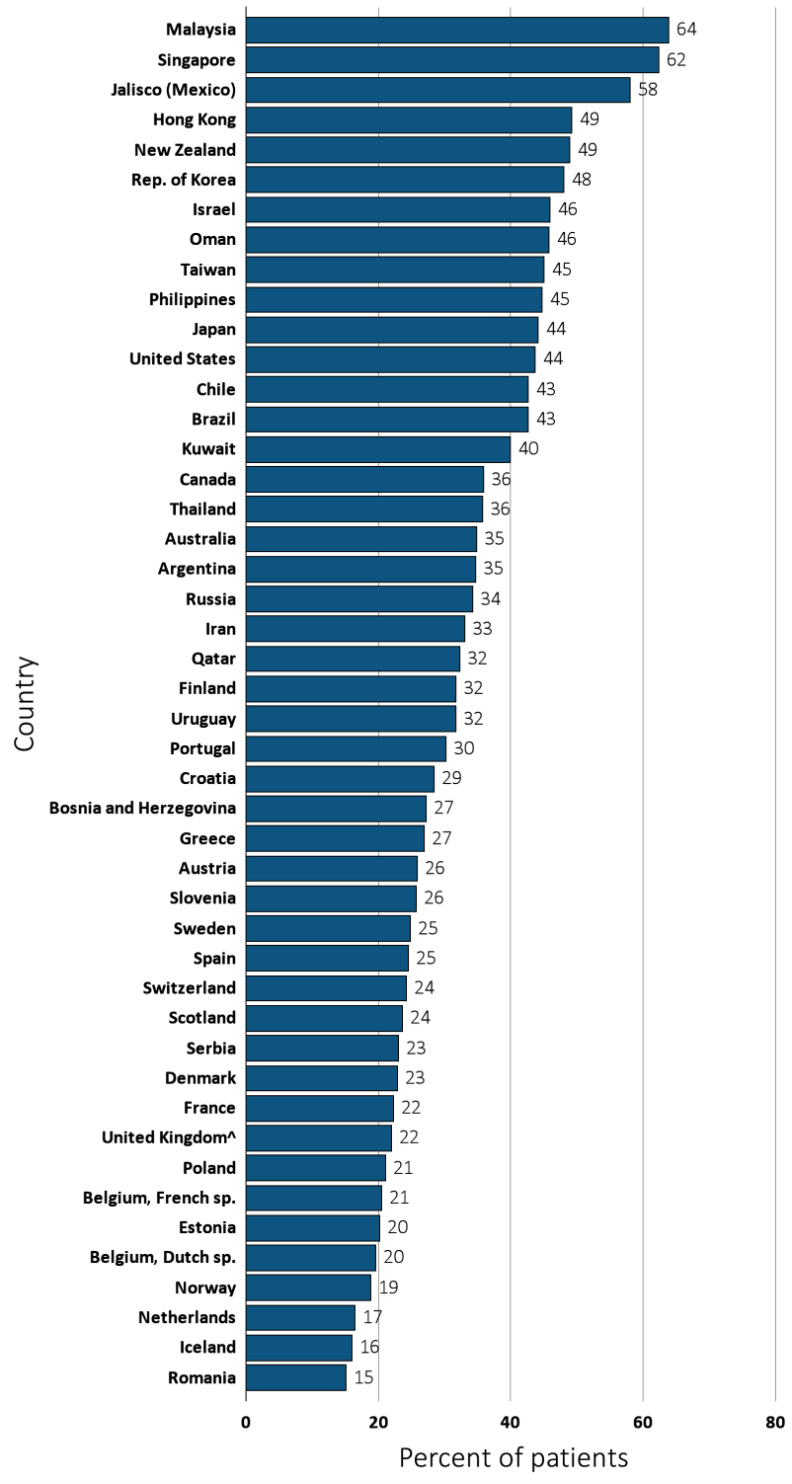
Figure 13.4 Percentage of incident ESRD patients with diabetes as the primary ESRD cause,
^{by country, 2013}
Data Source: Special analyses, USRDS ESRD Database. Data presented only for countries from which relevant information was available. ^United Kingdom: England, Wales, Northern Ireland (Scotland data reported separately). Data for Spain include 18 of 19 regions. Data for France include 22 regions. Data for Indonesia represent the West Java region. Data for Belgium do not include patients younger than 20. Abbreviations: ESRD, end-stage renal disease; sp., speaking.

Slide 8
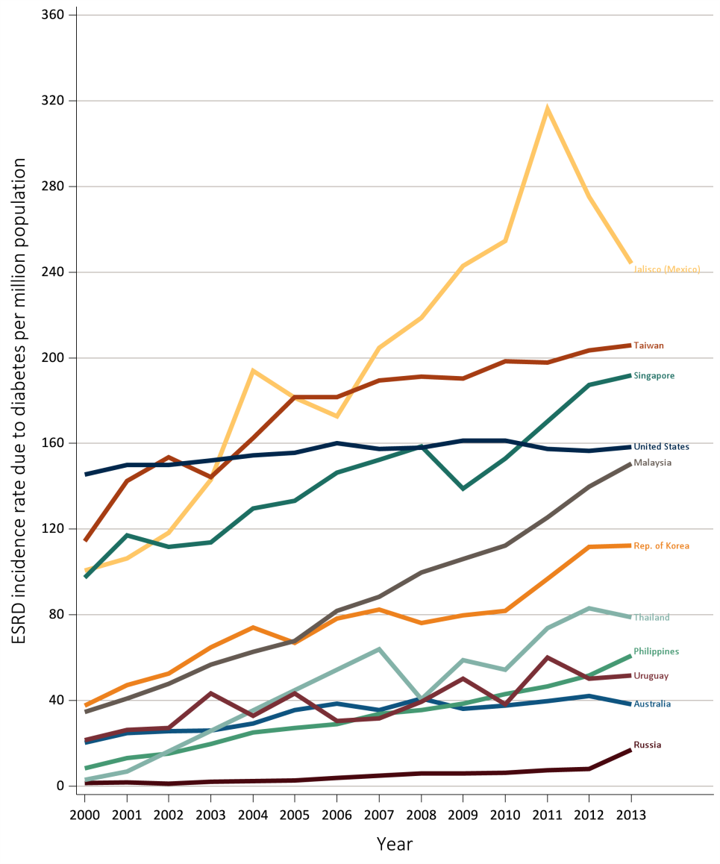
Figure 13.5 Trends in the incidence of treated ESRD due to diabetes,
per million population, 2000-2013
Ten countries having the highest % rise from 2000/01 to 2012/13, plus the U.S.
Data Source: Special analyses, USRDS ESRD Database. All rates are unadjusted. Data presented only for countries from which relevant information was available. Data for U.S. are shown for comparison purposes. Abbreviations: ESRD, end-stage renal disease.

Slide 9
Table 13.2 Trends in the incidence of treated ESRD due to diabetes,
per million population, 2000-2013
Country | 2000 | 2001 | 2002 | 2003 | 2004 | 2005 | 2006 | 2007 | 2008 | 2009 | 2010 | 2011 | 2012 | 2013 | % change from 2000/01 to 2012/13
Argentina | . | . | . | . | 43.1 | 48.7 | 47.6 | 50.1 | 51.1 | 52.1 | 53.5 | 54.9 | 56.2 | 56.2 | .
Australia | 20.4 | 24.9 | 25.8 | 25.9 | 29.3 | 35.6 | 38.5 | 35.7 | 40.9 | 36.1 | 37.7 | 39.9 | 42.1 | 38.4 | 77.7
Austria | 43.6 | 44.5 | 46.6 | 47.0 | 51.9 | 51.5 | 52.7 | 48.8 | 47.8 | 44.9 | 42.1 | 40.6 | 37.1 | 36.7 | -16.2
Bahrain | . | . | . | . | . | . | . | . | 71.4 | 71.3 | 70.5 | 81.2 | . | . | .
Belgium, Dutch sp. | 31.3 | 38.1 | 38.9 | 42.0 | 44.3 | 44.4 | 42.8 | 44.5 | 44.5 | 48.3 | 41.6 | 38.4 | 35.3 | 36.6 | 3.6
Belgium, French sp. | . | 36.5 | 38.9 | 40.1 | 39.6 | 41.9 | 42.0 | 42.6 | 44.2 | 49.3 | 40.7 | 38.6 | 41.7 | 37.4 | 8.4
Bosnia and Herzegovina | . | . | . | 24.3 | 21.7 | 21.4 | 28.4 | 29.7 | 30.3 | 43.1 | 32.4 | 31.4 | 36.2 | 31.6 | .
Brazil | . | . | . | . | . | . | . | . | 50.2 | . | . | . | . | 77.4 | .
Canada | 49.8 | 53.3 | 53.1 | 55.4 | 56.2 | 57.2 | 56.9 | 58.4 | 57.6 | 57.4 | 59.5 | 58.1 | 60.8 | 54.5 | 11.8
Chile | . | . | . | . | . | . | . | . | . | . | . | . | . | 90.6 | .
Colombia | . | . | . | . | 31.9 | 36.2 | 57.5 | 58.4 | 35.1 | 26.1 | 52.2 | 31.1 | . | . | .
Croatia | . | . | . | . | . | . | . | . | . | . | . | . | 37.5 | 44.6 | .
Czech Republic | 49.6 | 55.3 | . | . | . | . | . | . | . | . | . | . | . | . | .
Denmark | 28.5 | 31.7 | 34.6 | 29.9 | 28.2 | 29.4 | 28.0 | 34.6 | 28.8 | 30.1 | 27.7 | 30.6 | 34.9 | 26.8 | 2.5
Estonia | . | . | . | . | . | . | . | . | . | . | . | . | . | 12.9 | .
Finland | 30.3 | 30.8 | 36.7 | 33.2 | 32.3 | 33.5 | 31.0 | 33.5 | 31.8 | 27.9 | 29.1 | 30.4 | 28.3 | 28.3 | -7.4
France | . | . | . | . | . | 32.1 | 30.7 | 30.9 | 33.6 | 34.5 | 34.7 | 33.8 | 34.1 | 35.7 | .
Greece | 41.0 | 44.6 | 45.0 | 50.4 | 55.6 | 56.9 | 58.3 | 53.3 | 58.6 | 57.0 | 55.7 | 55.2 | 54.5 | 58.0 | 31.4
Hong Kong | . | . | 60.5 | 51.2 | 57.2 | 59.7 | 59.9 | 66.6 | 62.7 | 65.4 | 69.3 | 72.5 | 79.0 | 81.0 | .
Hungary | . | . | . | . | . | . | . | . | 91.4 | 91.2 | 101.9 | 91.4 | 91.6 | . | .
Iceland | 3.6 | 14.0 | 7.0 | . | 3.4 | 3.4 | 19.8 | 9.7 | 12.6 | 15.7 | 15.7 | 40.8 | . | 12.4 | 40.9
Iran | . | . | . | . | . | . | . | . | 22.1 | 23.2 | 24.6 | 24.6 | 24.8 | 24.9 | .
Israel | . | . | 65.3 | 73.3 | 79.6 | 75.8 | 80.7 | 80.8 | 78.4 | 83.4 | 83.7 | 90.5 | 89.2 | 83.3 | .
Italy | . | . | . | . | . | . | . | . | . | . | 34.0 | . | . | . | .
Jalisco (Mexico) | 100.6 | 106.5 | 118.2 | 143.0 | 193.8 | 181.4 | 172.7 | 204.7 | 218.8 | 243.0 | 254.5 | 316.2 | 275.2 | 244.1 | 150.7
Japan | 87.9 | 95.7 | 99.1 | 106.8 | 109.1 | 112.6 | 117.1 | 123.3 | 124.2 | 128.1 | 127.7 | 131.3 | 126.8 | 126.0 | 37.7
Rep. of Korea | 37.7 | 47.3 | 52.7 | 64.8 | 74.1 | 66.8 | 78.4 | 82.4 | 76.3 | 79.8 | 82.0 | 96.7 | 111.9 | 112.3 | 163.8
Malaysia | 34.8 | 41.0 | 47.8 | 56.9 | 62.8 | 67.7 | 81.9 | 88.5 | 99.7 | 106.2 | 112.3 | 125.6 | 139.8 | 150.7 | 283.2
^{(Continue} ^{on the next slide)}

Slide 10
Table 13.2 Trends in the incidence of treated ESRD due to diabetes,
per million population, 2000-2013 (Continued)
Country | 2000 | 2001 | 2002 | 2003 | 2004 | 2005 | 2006 | 2007 | 2008 | 2009 | 2010 | 2011 | 2012 | 2013 | % change from 2000/01 to 2012/13
Morelos (Mexico) | . | . | . | . | . | . | . | 287.5 | 333.4 | 346.9 | . | . | . | . | .
Netherlands | 15.6 | 16.3 | 17.8 | 17.1 | 18.4 | 16.7 | 18.4 | 21.5 | 22.2 | 18.8 | 18.8 | 20.5 | 20.1 | 19.0 | 22.6
New Zealand | 39.1 | 45.6 | 52.8 | 47.6 | 45.7 | 46.9 | 50.4 | 45.6 | 53.3 | 64.8 | 59.8 | 46.8 | 57.2 | 60.1 | 38.5
Norway | 13.6 | 13.7 | 11.0 | 15.1 | 17.4 | 12.8 | 16.5 | 15.3 | 20.3 | 21.3 | 17.8 | 14.5 | 17.1 | 19.1 | 32.6
Oman | . | . | . | . | . | . | . | . | 45.9 | 48.0 | 48.0 | 52.0 | 52.0 | 55.0 | .
Philippines | 8.4 | 13.3 | 15.2 | 19.7 | 25.1 | 27.1 | 29.0 | 33.8 | 35.5 | 38.7 | 43.0 | 46.5 | 51.8 | 60.9 | 419.4
Poland | . | . | . | . | . | . | . | . | 31.2 | 28.7 | 26.3 | 30.0 | 30.7 | 26.7 | .
Portugal | . | . | . | . | . | . | . | . | 75.7 | 72.3 | 75.2 | 75.7 | 68.5 | 69.4 | .
Qatar | . | . | . | . | . | . | . | . | . | . | 32.1 | 32.9 | 32.9 | 32.3 | .
Romania | . | . | . | . | . | 10.1 | 9.2 | 10.5 | 12.1 | 15.7 | 19.6 | 18.4 | 19.7 | 21.9 | .
Russia | 1.6 | 1.8 | 1.3 | 2.1 | . | 2.7 | 3.8 | . | 6.1 | 5.9 | 6.2 | 7.4 | 8.1 | 17.2 | 644.1
Saudi Arabia | . | . | . | . | . | . | . | . | 48.4 | 45.3 | 42.2 | 48.2 | 50.4 | . | .
Scotland | 19.9 | 18.8 | 20.4 | 22.9 | 20.7 | 27.7 | 25.8 | 23.1 | 23.4 | 25.4 | 23.2 | 22.3 | 28.0 | 22.7 | 31
Serbia | . | . | . | . | . | . | . | . | . | . | . | 33.4 | 33.1 | 34.0 | .
Singapore | 97.4 | 117.2 | 111.7 | 113.8 | 129.8 | 133.2 | 146.4 | 152.4 | 158.7 | 139.0 | 153.0 | 170.2 | 187.3 | 191.7 | 76.6
Slovenia | . | . | . | . | . | . | . | . | . | 31.9 | 30.3 | 31.7 | 35.0 | 32.5 | .
Spain | . | . | . | . | 30.6 | 29.3 | 29.9 | 26.0 | 28.9 | 25.6 | 29.8 | 29.3 | 29.9 | 31.3 | .
Sweden | 33.0 | 32.1 | 30.6 | 29.4 | 30.9 | 31.3 | 33.9 | 35.4 | 29.0 | 32.0 | 29.8 | 30.2 | 26.2 | 28.6 | -15.8
Switzerland | . | . | . | . | . | . | . | . | . | . | . | . | . | 22.8 | .
Taiwan | 114.4 | 142.5 | 153.6 | 144.2 | 162.6 | 181.8 | 181.8 | 189.5 | 191.1 | 190.2 | 198.4 | 197.8 | 203.4 | 205.8 | 59.3
Thailand | 3.1 | 7.0 | . | . | . | . | . | 64.0 | 40.7 | 58.8 | 54.5 | 73.9 | 83.2 | 78.8 | 1504
Turkey | 26.7 | 37.1 | 54.5 | 25.8 | 25.9 | 54.0 | 44.2 | 52.2 | 70.5 | 68.6 | 76.9 | 78.4 | . | . | .
Ukraine | . | . | . | . | . | . | . | . | . | . | . | . | 3.0 | . | .
United Kingdom^ | . | . | . | . | 19.1 | 21.0 | 23.7 | 23.7 | 23.9 | 25.3 | 24.0 | 24.7 | 25.7 | 24.7 | .
United States | 145.6 | 150.0 | 150.1 | 152.2 | 154.5 | 155.8 | 160.2 | 157.4 | 158.0 | 161.4 | 161.4 | 157.6 | 156.6 | 158.5 | 6.6
Uruguay | 21.4 | 26.3 | 27.1 | 43.3 | 33.0 | 43.3 | 30.5 | 31.6 | 39.6 | 50.2 | 38.4 | 60.0 | 50.2 | 51.7 | 113.6
Data source: Special analyses, USRDS ESRD Database. All rates are unadjusted. Data presented only for countries from which relevant information was available. ^United Kingdom: England, Wales, Northern Ireland (Scotland data reported separately). Data for France include 15 regions in 2006, 18 regions in 2007, 20 regions in 2008, and 22 regions in 2009-2013. Data for Spain include 18 of 19 regions. Data for Belgium do not include patients younger than 20.
ª% change is calculated as the percent difference between the average incidence in 2012 and 2013 and the average in 2000 and 2001. Abbreviations: ESRD, end-stage renal disease.

Slide 11
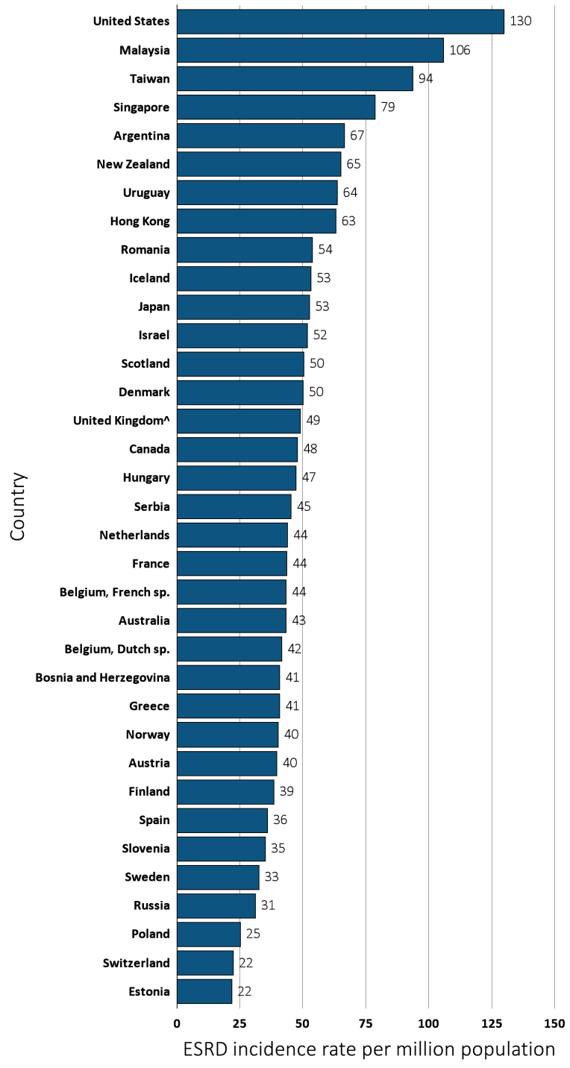
Figure 13.6 Incidence of treated ESRD, per million population, by age group and country, 2013
(a) 20-44 years old
Data source: Special analyses, USRDS ESRD Database. All rates are unadjusted. Data presented only for countries from which relevant information was available. ^United Kingdom: England, Wales, Northern Ireland (Scotland data reported separately). Data for Spain include 18 of 19 regions; Data for France include 22 regions. For graph (a) data for Spain include patients 15-44 years old, and data for the United States include patients 22-44 years old. Abbreviations: ESRD, end-stage renal disease; sp., speaking.

Slide 12
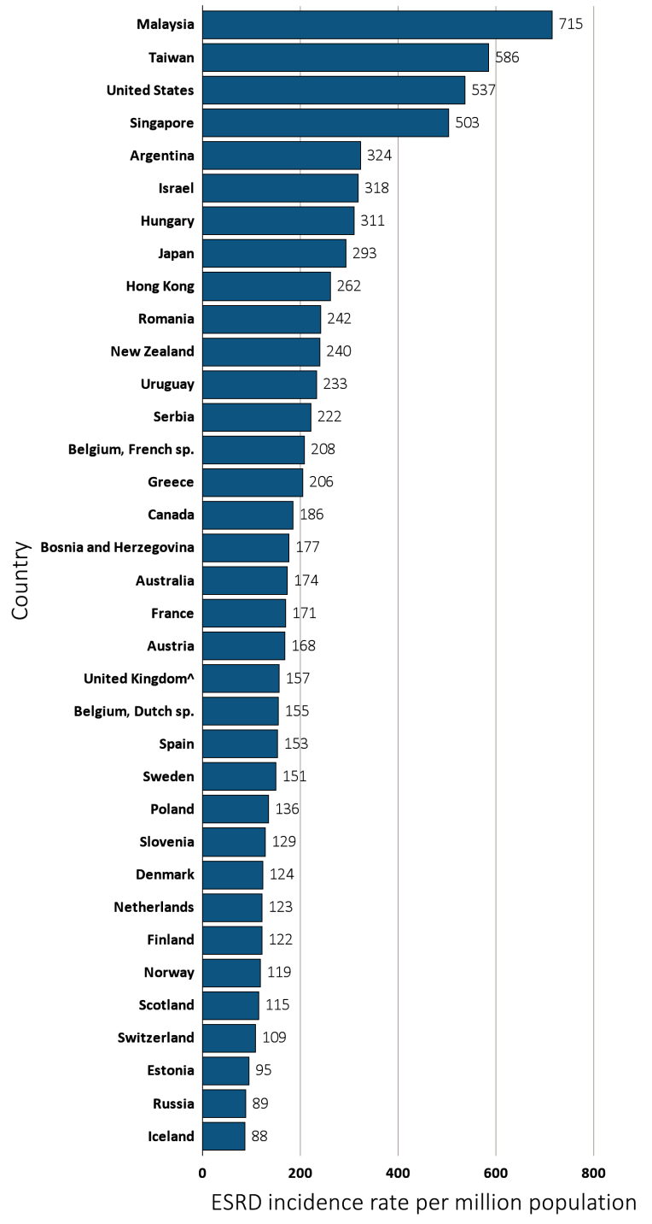
Figure 13.6 Incidence of treated ESRD, per million population, by age group and country, 2013
(a) 45-64 years old
Data source: Special analyses, USRDS ESRD Database. All rates are unadjusted. Data presented only for countries from which relevant information was available. ^United Kingdom: England, Wales, Northern Ireland (Scotland data reported separately). Data for Spain include 18 of 19 regions; Data for France include 22 regions. For graph (a) data for Spain include patients 15-44 years old, and data for the United States include patients 22-44 years old. Abbreviations: ESRD, end-stage renal disease; sp., speaking.

Slide 13
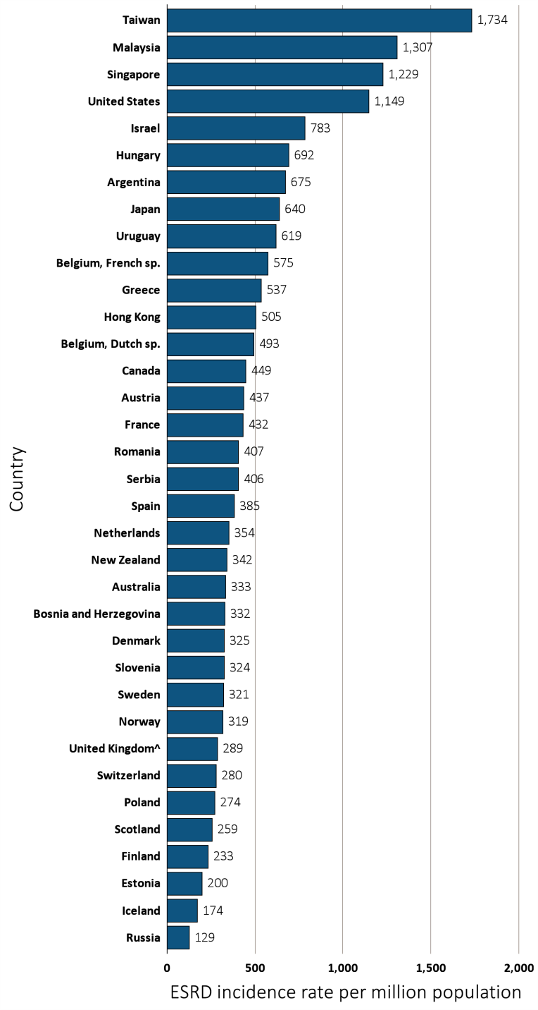
Figure 13.6 Incidence of treated ESRD, per million population, by age group and country, 2013
(a) 65-74 years old
Data source: Special analyses, USRDS ESRD Database. All rates are unadjusted. Data presented only for countries from which relevant information was available. ^United Kingdom: England, Wales, Northern Ireland (Scotland data reported separately). Data for Spain include 18 of 19 regions; Data for France include 22 regions. For graph (a) data for Spain include patients 15-44 years old, and data for the United States include patients 22-44 years old. Abbreviations: ESRD, end-stage renal disease; sp., speaking.

Slide 14
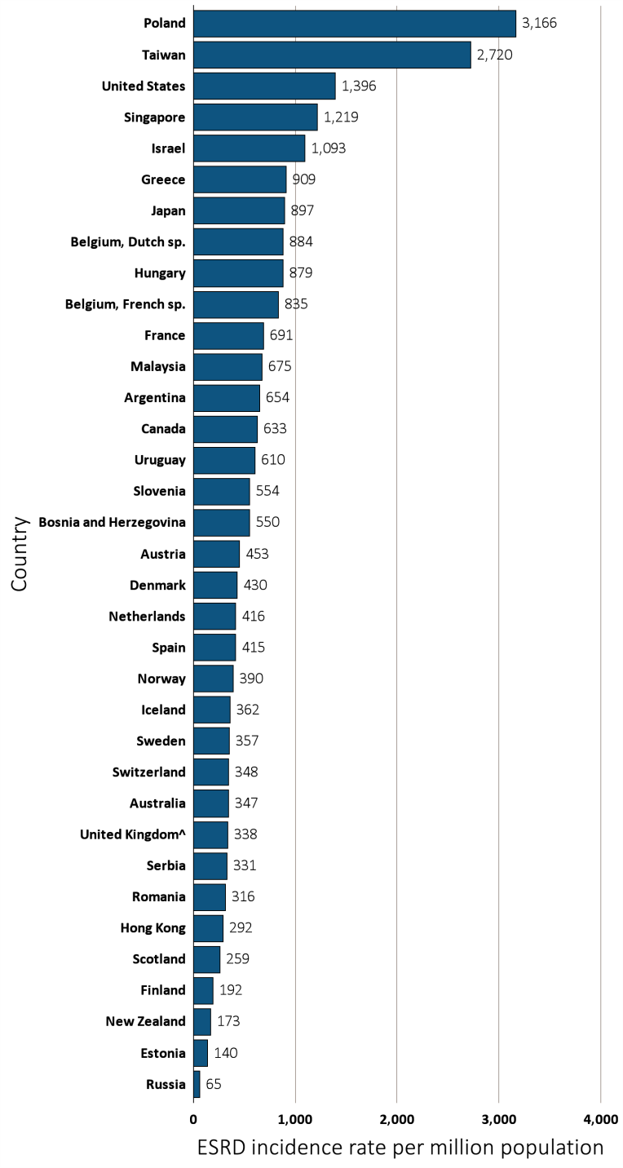
Figure 13.6 Incidence of treated ESRD, per million population, by age group and country, 2013
(a) ≥ 75 years old
Data source: Special analyses, USRDS ESRD Database. All rates are unadjusted. Data presented only for countries from which relevant information was available. ^United Kingdom: England, Wales, Northern Ireland (Scotland data reported separately). Data for Spain include 18 of 19 regions; Data for France include 22 regions. For graph (a) data for Spain include patients 15-44 years old, and data for the United States include patients 22-44 years old. Abbreviations: ESRD, end-stage renal disease; sp., speaking.

Slide 15
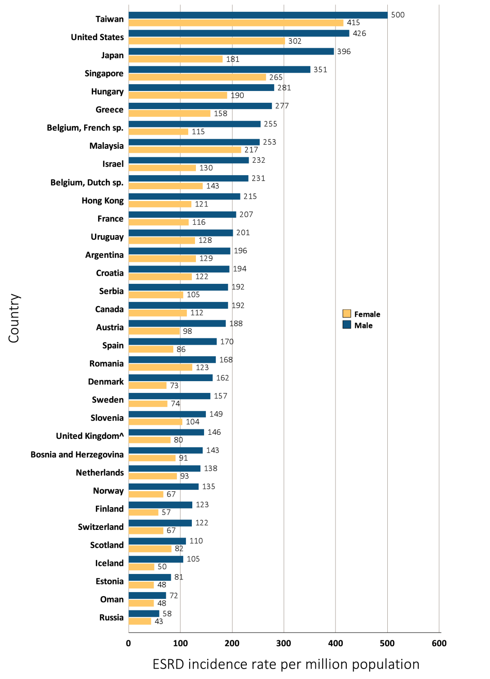
Figure 13.7 Incidence of treated ESRD,
per million population, by sex and country, 2013
Data source: Special analyses, USRDS ESRD Database. All rates are unadjusted. Data presented only for countries from which relevant information was available. ^United Kingdom: England, Wales, Northern Ireland (Scotland data reported separately). Data for Belgium do not include patients younger than 20. Data for Spain include 18 of 19 regions. Data for France include 22 regions. Abbreviations: ESRD, end-stage renal disease; sp., speaking.

Slide 16
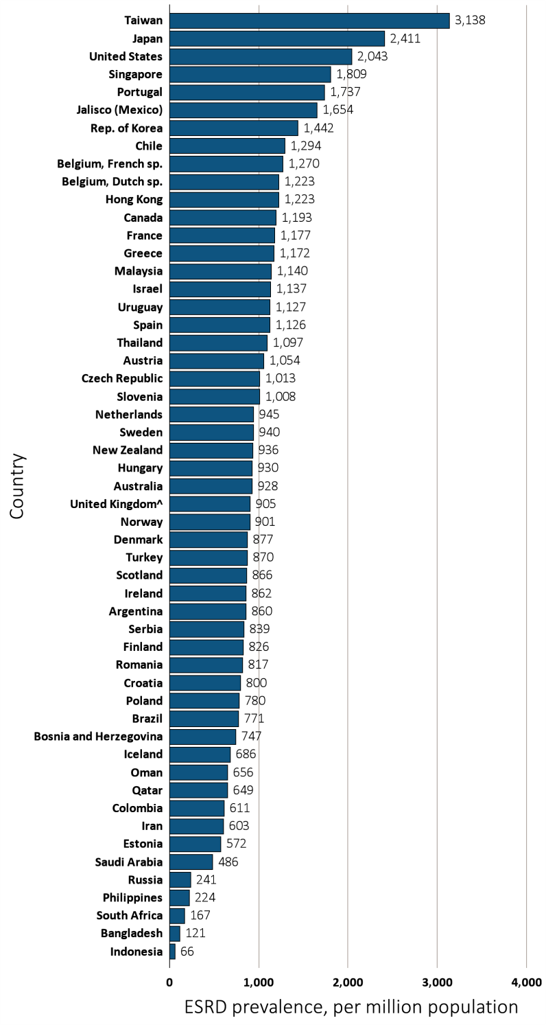
Figure 13.8 Prevalence of treated ESRD, per million population, by country, 2013
Data source: Special analyses, USRDS ESRD Database. Data presented only for countries from which relevant information was available. The prevalence is unadjusted and reflects prevalence at the end of 2013. ^United Kingdom: England, Wales, Northern Ireland (Scotland data reported separately). Japan and Taiwan include dialysis patients only. Data for Belgium do not include patients younger than 20. Data for Indonesia represent the West Java region. Data for Spain include 18 of 19 regions. Data for France include 22 regions. Abbreviations: ESRD, end-stage renal disease; sp., speaking.

Slide 17
Table 13.3 Number of prevalent ESRD patients and prevalence of ESRD,
per million population, by country, 2000-2013
 | ESRD prevalence, per million population
Country |  | 2000 | 2001 | 2002 | 2003 | 2004 | 2005 | 2006 | 2007 | 2008 | 2009 | 2010 | 2011 | 2012 | 2013 |  | % change from 2000/01 to 2012/13
Argentina |  | . | . | . | . | 550.3 | 578.7 | 598.0 | 615.4 | 755.7 | 761.9 | 781.7 | 774.9 | 819.9 | 859.9 |  | .
Australia |  | 608.6 | 634.5 | 662.7 | 688.6 | 709.8 | 746.5 | 778.3 | 801.3 | 839.0 | 853.4 | 872.1 | 891.3 | 912.7 | 928.4 |  | 48.1
Austria |  | 714.7 | 755.2 | 781.6 | 859.1 | 854.4 | 889.4 | 908.6 | 933.5 | 947.9 | 980.8 | 992.3 | 1001.0 | 1025.3 | 1053.7 |  | 41.4
Bahrain |  | . | . | . | . | . | . | . | . | 291.0 | 300.4 | 280.3 | 339.7 | . | . |  | .
Bangladesh |  | 52.7 | 58.9 | 64.6 | 72.0 | 72.5 | 80.2 | 87.8 | 101.3 | 112.8 | 107.5 | 113.0 | 105.0 | 122.3 | 120.7 |  | 117.7
Belgium, Dutch sp. |  | 790.4 | 834.4 | 879.0 | 909.8 | 950.0 | 993.7 | 1033.1 | 1063.8 | 1096.0 | 1138.6 | 1164.0 | 1184.6 | 1205.9 | 1223.1 |  | 49.5
Belgium, French sp. |  | . | 828.6 | 885.3 | 933.0 | 987.1 | 1022.2 | 1071.5 | 1110.7 | 1145.7 | 1128.1 | 1165.0 | 1193.2 | 1232.6 | 1269.9 |  | 51
Bosnia and Herzegovina |  | . | . | . | 477.3 | 487.2 | 524.2 | 551.9 | 601.8 | 637.0 | 646.4 | 675.1 | 709.8 | 718.9 | 746.9 |  | .
Brazil |  | . | . | . | 338.1 | 367.5 | 388.9 | 398.3 | 466.0 | 408.5 | 475.8 | 467.1 | 671.2 | 720.2 | 771.1 |  | .
Canada |  | 807.6 | 856.9 | 899.9 | 933.1 | 972.2 | 1006.1 | 1039.1 | 1071.1 | 1094.1 | 1118.6 | 1135.5 | 1158.3 | 1175.7 | 1192.6 |  | 42.3
Chile |  | 611.5 | 671.6 | 725.8 | 772.8 | 840.9 | 865.8 | 929.6 | 985.7 | 1065.2 | 1108.8 | 1161.1 | 1235.7 | 1263.4 | 1293.8 |  | 99.3
Colombia |  | . | . | . | . | . | . | . | . | 455.3 | 441.3 | 544.2 | 536.3 | 578.4 | 611.3 |  | .
Croatia |  | 621.5 | 657.0 | 699.1 | 789.7 | 806.8 | 835.5 | . | . | . | . | . | . | 1033.0 | 799.5 |  | 43.3
Czech Republic |  | 620.9 | 662.2 | 695.1 | 707.7 | 757.6 | 452.4 | 461.9 | 499.9 | 538.1 | 907.6 | 970.1 | 974.4 | . | 1012.8 |  | 57.9
Denmark |  | 639.6 | 685.3 | 716.5 | 743.2 | 755.8 | 770.4 | 781.8 | 832.2 | 832.1 | 842.6 | 846.3 | 856.7 | 871.6 | 876.9 |  | 32
Estonia |  | . | . | . | . | . | . | . | . | . | . | . | . | . | 572.1 |  | .
Finland |  | 582.3 | 613.0 | 635.5 | 663.9 | 688.8 | 715.8 | 727.1 | 747.4 | 769.2 | 783.5 | 798.6 | 807.5 | 811.8 | 825.9 |  | 37
France |  | . | . | . | . | . | 916.9 | 962.6 | 953.9 | 993.1 | 1052.5 | 1089.2 | 1118.6 | 1142.9 | 1177.4 |  | .
Greece |  | 799.9 | 815.6 | 842.1 | 880.8 | 922.7 | 958.3 | 986.1 | 1013.4 | 1038.9 | 1069.7 | 1083.8 | 1104.1 | 1136.6 | 1172.1 |  | 42.9
Hong Kong |  | . | 787.5 | 843.0 | 877.7 | 927.8 | 970.3 | 1003.0 | 1031.4 | 1067.4 | 1128.9 | 1145.8 | 1159.1 | 1194.9 | 1222.5 |  | 53.5
Hungary |  | . | . | . | . | . | . | . | . | 578.1 | 868.6 | 889.9 | 904.7 | 919.8 | 929.6 |  | .
Iceland |  | 362.7 | 407.1 | 434.7 | 480.1 | 475.9 | 475.2 | 483.9 | 518.5 | 523.0 | 536.9 | 594.3 | 661.4 | 676.6 | 685.7 |  | 77
Indonesia |  | . | . | . | . | . | . | . | . | . | 27.9 | 37.3 | 40.1 | 50.6 | 65.9 |  | .
Iran |  | . | . | . | . | . | . | . | . | 490.6 | 524.3 | 544.4 | 564.2 | 583.3 | 603.4 |  | .
Ireland |  | . | . | . | . | . | . | . | . | . | 769.2 | 801.6 | 825.2 | 845.3 | 862.2 |  | .
Israel |  | 526.0 | 542.0 | 577.7 | 896.3 | 934.7 | 973.6 | 1010.1 | 1040.7 | 1070.8 | 1086.6 | 1101.9 | 1120.2 | 1125.4 | 1136.7 |  | 111.8
Jalisco (Mexico) |  | 270.3 | 337.9 | 389.5 | 394.4 | 507.6 | 807.9 | 928.9 | 986.2 | 1029.6 | 1314.3 | 1332.3 | 1381.5 | 1408.8 | 1653.5 |  | 403.5
Japan |  | 1616.2 | 1640.3 | 1727.0 | 1795.2 | 1850.9 | 1879.8 | 1954.5 | 2058.1 | 2126.0 | 2205.4 | 2277.4 | 2313.8 | 2365.2 | 2411.1 |  | 46.7
Rep. of Korea |  | 584.5 | 642.2 | 700.6 | 794.5 | 854.0 | 899.8 | 941.7 | 972.8 | 1031.7 | 1113.6 | 1144.4 | 1224.8 | 1353.3 | 1441.5 |  | 127.8
Lebanon |  | . | . | . | . | . | . | . | . | . | . | . | . | 855.0 | . |  | .
^{(Continue} ^{on the next slide)}

Slide 18
Table 13.3 Number of prevalent ESRD patients and prevalence of ESRD,
per million population, by country, 2000-2013 (Continued)
 | ESRD prevalence, per million population
Country | 2000 | 2001 | 2002 | 2003 | 2004 | 2005 | 2006 | 2007 | 2008 | 2009 | 2010 | 2011 | 2012 | 2013 | % change from 2000/01 to 2012/13
Malaysia | 338.4 | 382.3 | 429.4 | 476.8 | 526.9 | 577.4 | 626.3 | 692.5 | 769.4 | 828.1 | 903.1 | 974.8 | 1060.5 | 1140.4 | 205.4
Netherlands | 617.1 | 636.2 | 656.0 | 678.4 | 703.7 | 733.5 | 772.2 | 802.5 | 820.2 | 850.4 | 873.2 | 894.1 | 918.2 | 945.4 | 48.7
New Zealand | 610.6 | 652.2 | 689.2 | 719.1 | 733.9 | 754.0 | 775.5 | 793.2 | 812.0 | 857.2 | 880.8 | 884.6 | 904.7 | 935.6 | 45.7
Norway | 581.2 | 611.9 | 642.8 | 667.9 | 708.9 | 732.4 | 753.1 | 784.0 | 816.9 | 844.1 | 859.2 | 875.0 | 887.9 | 900.5 | 49.9
Oman | . | . | . | . | . | . | . | . | 463.5 | 499.7 | 618.7 | 663.2 | 713.9 | 655.8 | .
Philippines | 48.4 | . | 22.3 | 46.0 | 52.3 | 91.1 | 80.6 | 84.6 | 109.8 | 119.2 | 136.9 | 163.2 | 185.1 | 224.4 | 323
Poland | . | . | . | . | . | . | . | . | 647.5 | 672.4 | 665.5 | 706.7 | 732.2 | 779.8 | .
Portugal | . | . | . | . | . | . | . | . | 1406.8 | 1505.1 | 1589.5 | 1662.0 | 1670.3 | 1736.9 | .
Qatar | . | . | . | . | . | . | . | . | . | . | 601.2 | 627.9 | 647.4 | 649.1 | .
Romania | . | . | . | . | . | 254.4 | 304.7 | 368.3 | 422.4 | 555.6 | 625.1 | 694.4 | 766.1 | 816.9 | .
Russia | 64.8 | 73.8 | 79.3 | 90.9 | 102.2 | 114.9 | 130.1 | . | 158.0 | 173.1 | 185.5 | 196.4 | 211.7 | 241.4 | 226.9
Saudi Arabia | . | . | . | . | . | . | . | . | 797.5 | 474.5 | 465.5 | 492.2 | 499.4 | 485.5 | .
Scotland | 634.5 | 661.2 | 683.9 | 713.2 | 731.1 | 761.0 | 783.9 | 812.0 | 809.9 | 827.1 | 836.6 | 841.2 | 856.1 | 866.0 | 32.9
Serbia | . | . | . | . | . | . | . | . | . | . | . | 765.5 | 799.7 | 839.1 | .
Singapore | 1103.0 | 1176.1 | 1225.7 | 1271.6 | 1301.9 | 1345.3 | 1400.1 | 1441.8 | 1494.8 | 1526.9 | 1578.6 | 1661.8 | 1741.4 | 1809.1 | 55.8
Slovenia | . | . | . | . | . | . | . | . | . | 981.5 | 987.5 | 985.5 | 999.9 | 1008.3 | .
South Africa | . | . | . | . | . | . | . | . | . | . | . | . | 163.7 | 166.8 | .
Spain | . | . | . | . | 1098.5 | 868.4 | 961.0 | 956.2 | 994.8 | 886.2 | 1045.5 | 1074.7 | 1075.6 | 1125.7 | .
Sweden | 716.4 | 739.8 | 764.5 | 778.3 | 808.9 | 820.4 | 850.7 | 866.7 | 875.7 | 891.6 | 910.0 | 929.2 | 931.3 | 939.5 | 28.5
Taiwan | 1526.3 | 1643.7 | 1792.2 | 1899.8 | 1999.2 | 2101.4 | 2196.8 | 2285.1 | 2432.0 | 2667.3 | 2811.5 | 2923.1 | 3030.8 | 3137.7 | 94.6
Thailand | 98.4 | 114.8 | . | 237.9 | 243.4 | 220.1 | 286.0 | 419.8 | 496.9 | 552.8 | 639.3 | 749.8 | 905.9 | 1096.6 | 839.3
Turkey | 271.2 | 352.6 | 373.7 | 401.2 | 433.4 | 450.7 | 589.2 | 711.5 | 753.1 | 819.2 | 847.4 | 868.2 | 815.6 | 870.2 | 170.2
Ukraine | . | . | . | . | . | . | . | . | . | . | . | . | 131.3 | . | .
United Kingdom^ | . | . | . | . | 621.5 | 680.4 | 722.9 | 737.6 | 773.2 | 802.7 | 826.1 | 851.6 | 874.1 | 905.0 | .
United States | 1359.9 | 1415.7 | 1469.6 | 1520.5 | 1570.6 | 1619.7 | 1672.1 | 1722.5 | 1774.5 | 1831.5 | 1887.4 | 1936.2 | 1987.8 | 2042.5 | 45.2
Uruguay | 737.1 | 762.9 | 807.3 | 845.5 | 893.2 | 849.1 | 927.1 | 963.9 | 1016.5 | 1018.6 | 1033.2 | 1074.9 | 1072.6 | 1127.1 | 46.6
^{(Continue} ^{on the next slide)}

Slide 19
Table 13.3 Number of prevalent ESRD patients and prevalence of ESRD,
per million population, by country, 2000-2013 (Continued)
 | Prevalent patients, counts
Country | 2000 | 2001 | 2002 | 2003 | 2004 | 2005 | 2006 | 2007 | 2008 | 2009 | 2010 | 2011 | 2012 | 2013
Argentina | . | . | . | . | 21,034 | 22,333 | 23,306 | 24,218 | 30,035 | 30,580 | 31,885 | 31,975 | 34,218 | 36,290
Australia | 11,657 | 12,318 | 13,017 | 13,691 | 14,275 | 15,175 | 16,112 | 16,842 | 17,826 | 18,510 | 19,212 | 19,909 | 20,742 | 21,470
Austria | 5,770 | 6,091 | 6,303 | 6,940 | 6,925 | 7,232 | 7,512 | 7,731 | 7,898 | 8,195 | 8,325 | 8,432 | 8,657 | 8,906
Bahrain | . | . | . | . | . | . | . | . | 322 | 354 | 346 | 406 | 410 | .
Bangladesh | 6,746 | 7,537 | 8,265 | 9,220 | 10,274 | 11,565 | 12,864 | 15,089 | 17,068 | 16,068 | 17,080 | 16,050 | 18,922 | 18,900
Belgium, Dutch sp. | 4,700 | 4,975 | 5,260 | 5,464 | 5,728 | 6,023 | 6,300 | 6,531 | 6,779 | 7,094 | 7,309 | 7,497 | 7,677 | 7,823
Belgium, French sp. | . | 3,583 | 3,850 | 4,068 | 4,335 | 4,516 | 4,768 | 4,983 | 5,184 | 5,151 | 5,378 | 5,566 | 5,795 | 6,005
Bosnia and Herzegovina | . | . | . | 1,829 | 1,867 | 2,009 | 2,115 | 2,306 | 2,441 | 2,477 | 2,587 | 2,490 | 2,522 | 2,620
Brazil | . | . | . | 59,153 | 65,121 | 70,872 | 73,605 | 87,044 | 77,589 | 92,091 | 91,314 | 132,491 | 143,497 | 155,011
Canada | 24,784 | 26,581 | 28,222 | 29,542 | 31,057 | 32,467 | 33,898 | 35,274 | 36,465 | 37,742 | 38,749 | 39,942 | 41,009 | 41,931
Chile | 9,301 | 10,344 | 11,314 | 12,190 | 13,450 | 14,160 | 15,353 | 16,360 | 17,856 | 18,849 | 19,854 | 21,007 | 21,730 | 22,512
Colombia | . | . | . | . | . | . | . | . | 20,239 | 19,846 | 24,760 | 24,692 | 26,942 | 28,807
Croatia | 2,755 | 2,913 | 3,100 | 3,504 | 3,582 | 3,708 | 3,799 | 3,932 | 4,009 | 4,124 | 4,257 | 4,348 | 4,410 | 2,740
Czech Republic | 6,374 | 6,759 | 7,092 | 7,227 | 7,743 | 4,638 | 4,752 | 5,190 | 5,633 | 9,536 | 10,218 | 10,236 | . | 10,647
Denmark | 3,415 | 3,670 | 3,851 | 4,004 | 4,125 | 4,219 | 4,295 | 4,592 | 4,619 | 4,701 | 4,743 | 4,821 | 4,923 | 4,973
Estonia | . | . | . | . | . | . | . | . | . | . | . | . | . | 754
Finland | 3,014 | 3,180 | 3,305 | 3,461 | 3,601 | 3,755 | 3,829 | 3,953 | 4,087 | 4,183 | 4,283 | 4,351 | 4,395 | 4,492
France | . | . | . | . | . | 31,151 | 34,835 | 49,679 | 54,627 | 62,019 | 64,197 | 66,243 | 68,448 | 70,792
Greece | 8,480 | 8,942 | 9,266 | 9,705 | 10,207 | 10,641 | 10,994 | 11,343 | 11,674 | 12,069 | 12,255 | 12,477 | 12,608 | 12,832
Hong Kong | . | 5,300 | 5,670 | 5,937 | 6,307 | 6,635 | 6,930 | 7,171 | 7,460 | 7,580 | 7,857 | 8,197 | 8,549 | 8,787
Hungary | . | . | . | . | . | . | . | . | 5,807 | 8,713 | 8,912 | 9,034 | 9,135 | 9,211
Iceland | 102 | 116 | 125 | 139 | 139 | 141 | 147 | 161 | 166 | 171 | 189 | 211 | 217 | 222
Indonesia | . | . | . | . | . | . | . | . | . | . | . | . | . | .
Iran | . | . | . | . | . | . | . | . | 35,248 | 38,250 | 40,300 | 42,370 | 44,450 | 46,640
Ireland | . | . | . | . | . | . | . | . | . | 3,487 | 3,651 | 3,775 | 3,876 | 3,960
Israel | 3,350 | 3,528 | 3,796 | 5,995 | 6,364 | 6,747 | 7,125 | 7,472 | 7,826 | 8,134 | 8,400 | 8,699 | 8,902 | 9,161
Jalisco (Mexico) | 1,688 | 2,110 | 2,432 | 2,463 | 3,170 | 5,455 | 6,357 | 6,865 | 7,218 | 9,222 | 9,916 | 10,421 | 10,769 | 12,802
Japan | 205,139 | 208,791 | 220,196 | 229,110 | 236,334 | 240,170 | 249,718 | 262,968 | 271,471 | 281,212 | 289,415 | 295,706 | 301,545 | 306,925
Rep. of Korea | 28,046 | 31,014 | 33,993 | 38,790 | 41,891 | 44,333 | 46,730 | 48,675 | 51,989 | 56,396 | 58,860 | 63,341 | 70,211 | 75,042
Lebanon | . | . | . | . | . | . | . | . | . | . | . | . | 4,100 | .
^{(Continue} ^{on the next slide)}

Slide 20
Table 13.3 Number of prevalent ESRD patients and prevalence of ESRD,
per million population, by country, 2000-2013 (Continued)
 | Prevalent patients, counts
Country | 2000 | 2001 | 2002 | 2003 | 2004 | 2005 | 2006 | 2007 | 2008 | 2009 | 2010 | 2011 | 2012 | 2013
Malaysia | 7,951 | 9,180 | 10,531 | 11,943 | 13,479 | 15,086 | 16,805 | 18,825 | 21,191 | 23,442 | 25,589 | 28,234 | 31,113 | 33,887
Morelos (Mexico) | . | . | . | . | . | . | . | 1,447 | 1,561 | 1,638 | . | . | . | .
Netherlands | 9,827 | 10,209 | 10,594 | 11,008 | 11,457 | 11,970 | 12,623 | 13,146 | 13,488 | 14,057 | 14,508 | 14,926 | 15,384 | 15,887
New Zealand | 2,356 | 2,531 | 2,715 | 2,883 | 3,000 | 3,117 | 3,245 | 3,354 | 3,459 | 3,688 | 3,832 | 3,878 | 3,988 | 4,156
Norway | 2,610 | 2,762 | 2,917 | 3,049 | 3,255 | 3,386 | 3,510 | 3,692 | 3,895 | 4,076 | 4,201 | 4,334 | 4,456 | 4,574
Oman | . | . | . | . | . | . | . | . | 1,535 | 1,708 | 1,836 | 2,008 | 2,206 | 2,382
Philippines | 3,861 | . | 1,853 | 3,922 | 4,375 | 7,676 | 7,437 | 7,967 | 10,552 | 11,683 | 13,674 | 16,619 | 19,210 | 23,727
Poland | . | . | . | . | . | . | . | . | 24,783 | 25,665 | 25,635 | 27,236 | 28,226 | 30,131
Portugal | . | . | . | . | . | . | . | . | 14,965 | 16,011 | 16,788 | 17,553 | 17,641 | 18,345
Qatar | . | . | . | . | . | . | . | . | . | . | 1,031 | 1,088 | 1,181 | 1,408
Romania | . | . | . | . | . | 5,504 | 6,578 | 7,935 | 9,088 | 10,863 | 12,150 | 13,414 | 14,752 | 16,162
Russia | 9,508 | 10,770 | 11,517 | 13,175 | 14,720 | 16,483 | 18,486 | . | 22,234 | 24,246 | 26,327 | 27,989 | 30,349 | 34,680
Saudi Arabia | . | . | . | . | . | . | . | . | 19,334 | 12,040 | 12,633 | 13,356 | 14,171 | 14,562
Scotland | 3,245 | 3,347 | 3,457 | 3,607 | 3,713 | 3,877 | 4,011 | 4,177 | 4,186 | 4,296 | 4,369 | 4,419 | 4,549 | 4,614
Serbia | . | . | . | . | . | . | . | . | . | . | . | 5,223 | 5,412 | 5,651
Singapore | 3,611 | 3,912 | 4,147 | 4,281 | 4,444 | 4,665 | 4,936 | 5,165 | 5,445 | 5,701 | 5,954 | 6,297 | 6,648 | 6,955
Slovenia | . | . | . | . | . | . | . | . | . | 2,002 | 2,023 | 2,023 | 2,057 | 2,077
South Africa | . | . | . | . | . | . | . | . | . | . | . | . | 8,559 | 8,840
Spain | . | . | . | . | 39,578 | 28,366 | 35,462 | 41,546 | 44,067 | 39,708 | 47,632 | 50,614 | 50,837 | 50,565
Sweden | 6,356 | 6,581 | 6,823 | 6,972 | 7,275 | 7,408 | 7,725 | 7,929 | 8,074 | 8,291 | 8,534 | 8,780 | 8,865 | 9,020
Taiwan | 34,001 | 36,828 | 40,362 | 42,945 | 45,360 | 47,849 | 50,255 | 52,462 | 56,025 | 61,668 | 65,120 | 67,889 | 70,666 | 73,339
Thailand | 5,963 | 7,225 | . | 15,004 | 15,083 | 13,741 | 17,967 | 26,457 | 31,496 | 35,112 | 40,845 | 47,987 | 58,385 | 71,037
Turkey | 18,390 | 24,348 | 26,268 | 28,549 | 31,251 | 33,014 | 42,992 | 50,221 | 53,859 | 59,443 | 62,471 | 64,877 | 61,677 | 66,711
Ukraine | . | . | . | . | . | . | . | . | . | . | . | . | 5,985 | .
United Kingdom^ | . | . | . | . | 34,022 | 37,502 | 40,101 | 41,188 | 43,478 | 45,775 | 47,499 | 49,383 | 51,042 | 53,196
United States | 383,716 | 403,431 | 422,696 | 441,103 | 459,875 | 478,651 | 498,928 | 518,883 | 539,620 | 561,848 | 583,817 | 603,287 | 623,916 | 645,697
Uruguay |  | 2,551 | 2,715 | 2,675 | 2,895 | 2,807 | 3,073 | 3,204 | 3,389 | 3,407 | 3,468 | 3,532 | 3,525 | 3,704
Data source: Special analyses, USRDS ESRD Database. Data presented only for countries from which relevant information was available. ESRD prevalence is unadjusted and reflects prevalence at the end of each year. ^United Kingdom: England, Wales, Northern Ireland (Scotland data reported separately). Japan and Taiwan includes dialysis only; Israel includes dialysis patients only for 2000-2002. Data for France include 15 regions in 2006, 18 regions in 2007, 20 regions in 2008, and 22 regions in 2009-2013. Data for Spain include 18 of 19 regions. Data for Belgium do not include patients younger than 20. Data for Indonesia represent the West Java region. ª % change is calculated as the percent difference between the average prevalence in 2012 and 2013 and the average in 2000 and 2001. Abbreviations: ESRD, end-stage renal disease; sp., speaking; . signifies data not reported.

Slide 21
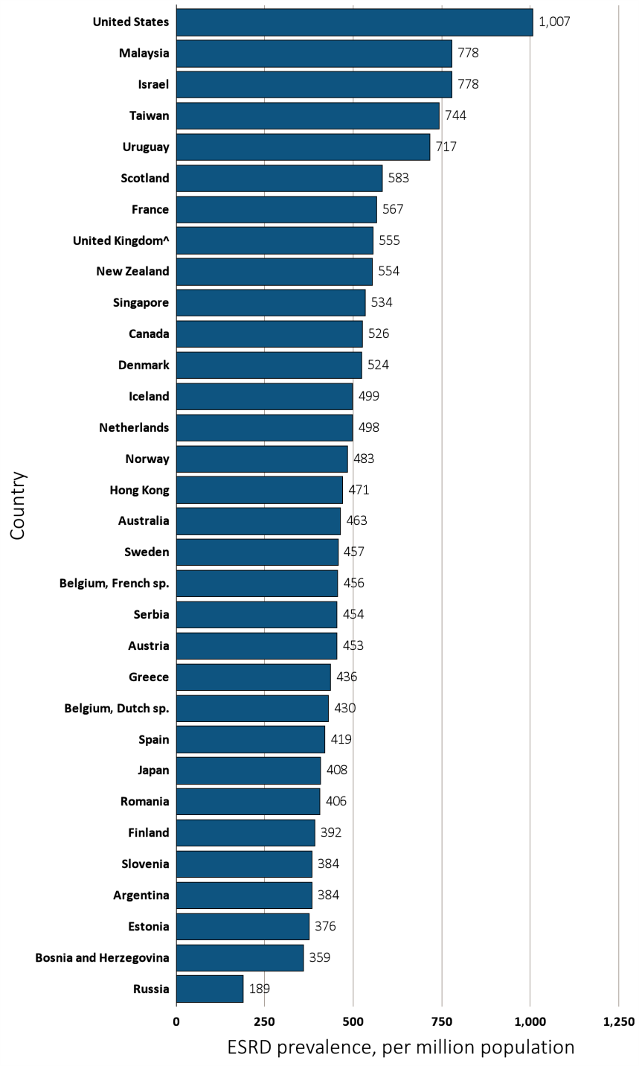
Figure 13.9 Prevalence of treated ESRD, per million population, by age group and country, 2013
(a) 20-44 years old
Data source: Special analyses, USRDS ESRD Database. Data presented only for countries from which relevant information was available. The prevalence is unadjusted and reflects prevalence at the end of 2013. ^United Kingdom: England, Wales, Northern Ireland (Scotland data reported separately). Japan and Taiwan include dialysis patients only. Data for Spain include 18 of 19 regions. Data for France include 22 regions. Abbreviations: ESRD, end-stage renal disease; sp., speaking.

Slide 22
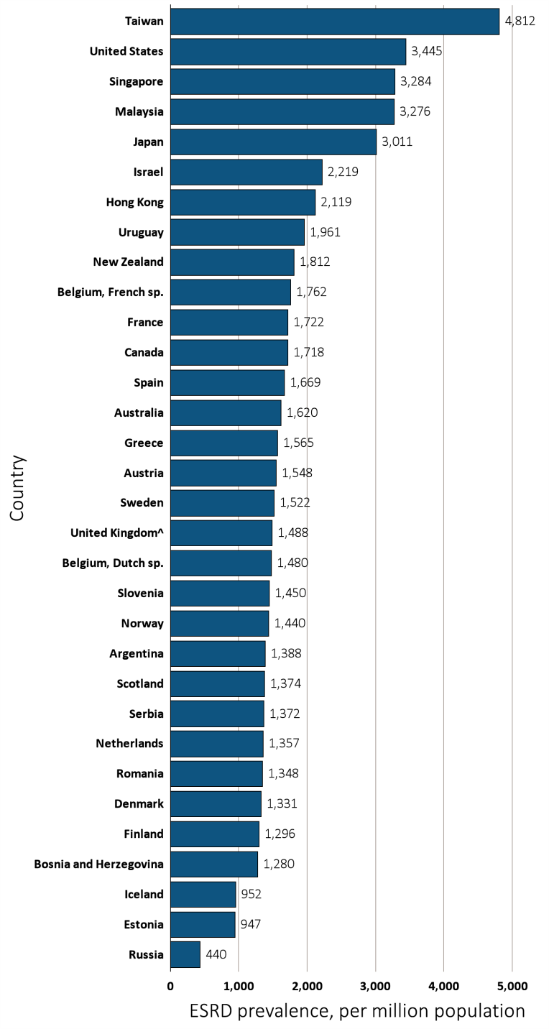
Figure 13.9 Prevalence of treated ESRD, per million population, by age group and country, 2013
(a) 45-64 years old
Data source: Special analyses, USRDS ESRD Database. Data presented only for countries from which relevant information was available. The prevalence is unadjusted and reflects prevalence at the end of 2013. ^United Kingdom: England, Wales, Northern Ireland (Scotland data reported separately). Japan and Taiwan include dialysis patients only. Data for Spain include 18 of 19 regions. Data for France include 22 regions. Abbreviations: ESRD, end-stage renal disease; sp., speaking.

Slide 23
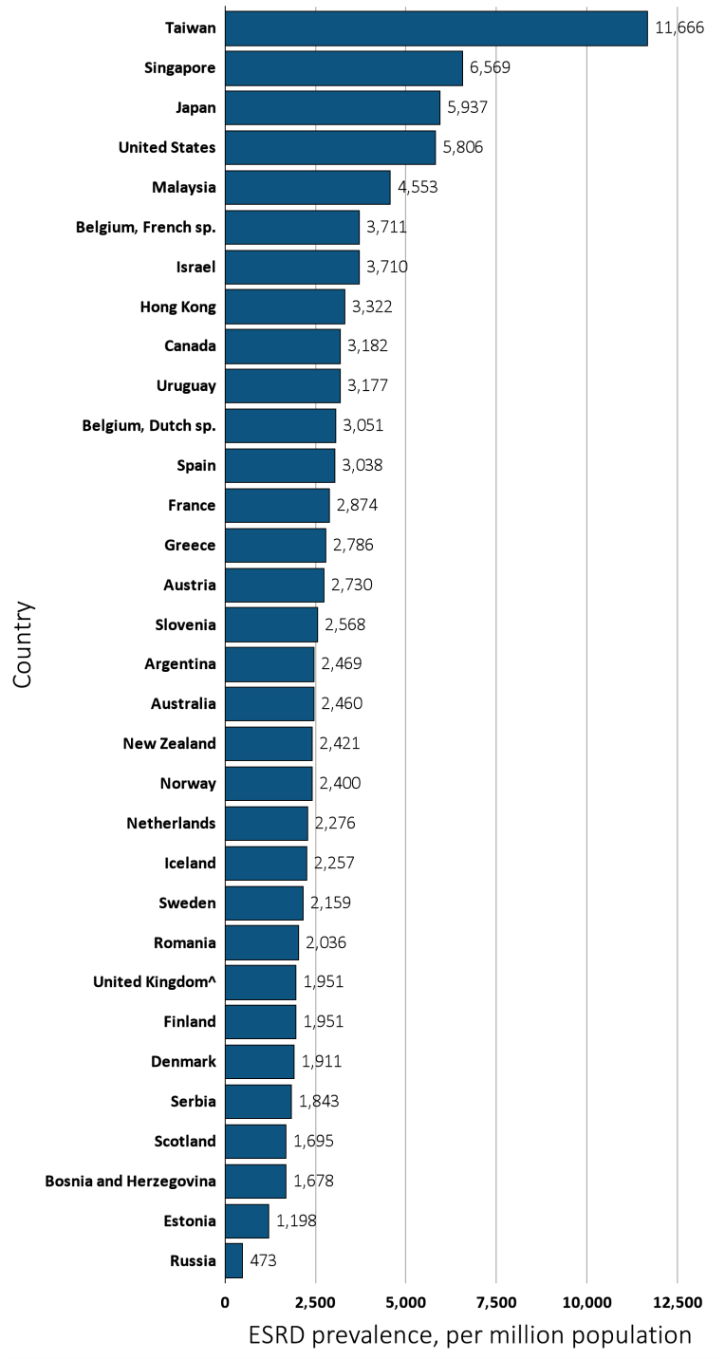
Figure 13.9 Prevalence of treated ESRD, per million population, by age group and country, 2013
(a) 65-74 years old
Data source: Special analyses, USRDS ESRD Database. Data presented only for countries from which relevant information was available. The prevalence is unadjusted and reflects prevalence at the end of 2013. ^United Kingdom: England, Wales, Northern Ireland (Scotland data reported separately). Japan and Taiwan include dialysis patients only. Data for Spain include 18 of 19 regions. Data for France include 22 regions. Abbreviations: ESRD, end-stage renal disease; sp., speaking.

Slide 24
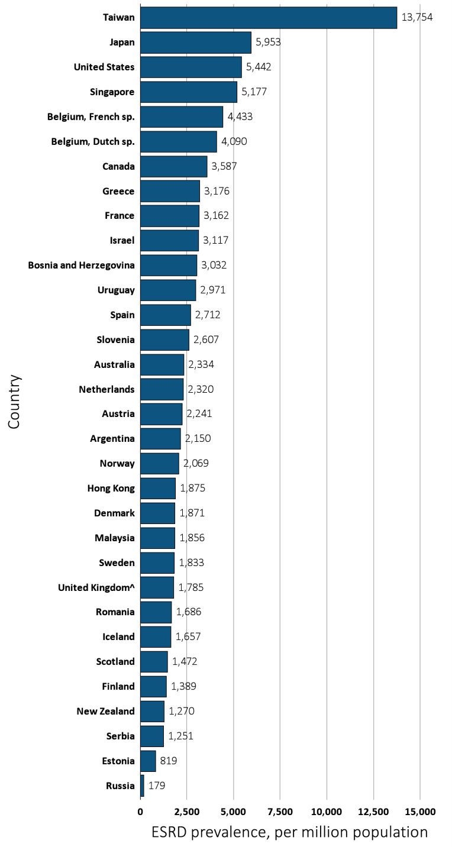
Figure 13.9 Prevalence of treated ESRD, per million population, by age group and country, 2013
(a)≥ 75 years old
Data source: Special analyses, USRDS ESRD Database. Data presented only for countries from which relevant information was available. The prevalence is unadjusted and reflects prevalence at the end of 2013. ^United Kingdom: England, Wales, Northern Ireland (Scotland data reported separately). Japan and Taiwan include dialysis patients only. Data for Spain include 18 of 19 regions. Data for France include 22 regions. Abbreviations: ESRD, end-stage renal disease; sp., speaking.

Slide 25
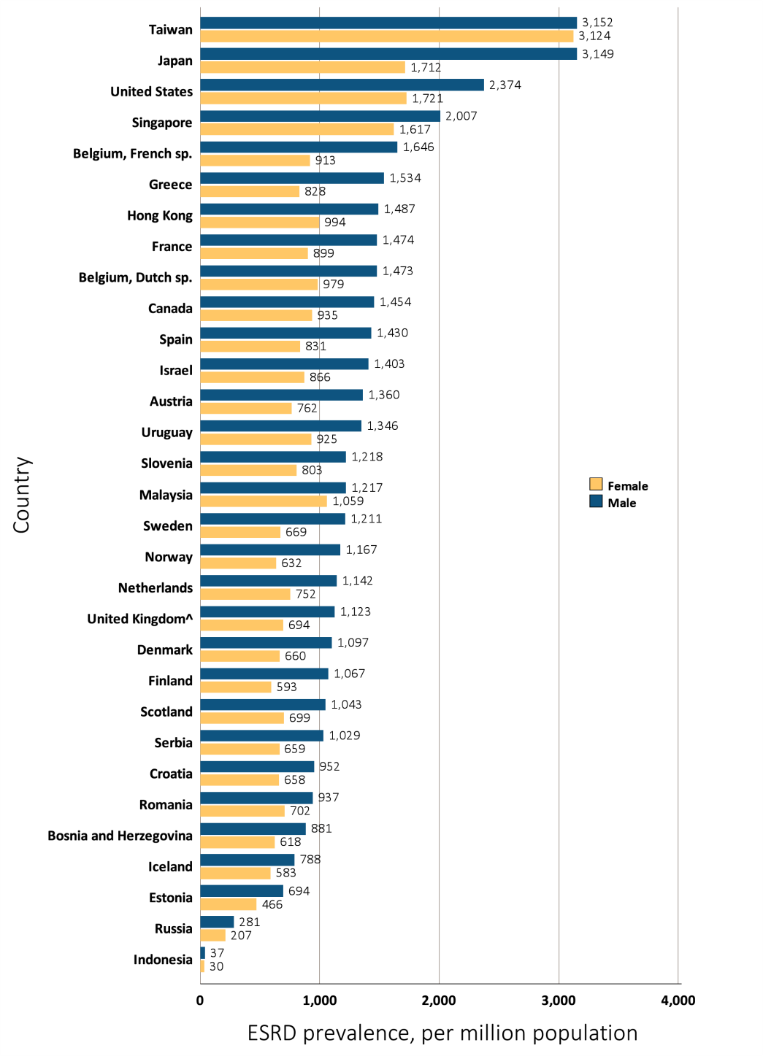
Figure 13.10 Prevalence of treated ESRD, per million population, by sex and country, 2013
Data source: Special analyses, USRDS ESRD Database. Data presented only for countries from which relevant information was available. The prevalence is unadjusted and reflects prevalence at the end of 2013. ^United Kingdom: England, Wales, Northern Ireland (Scotland data reported separately). Japan and Taiwan include dialysis patients only. Data for Spain include 18 of 19 regions. Data for France include 22 regions. Abbreviations: ESRD, end-stage renal disease; sp., speaking.

Slide 26
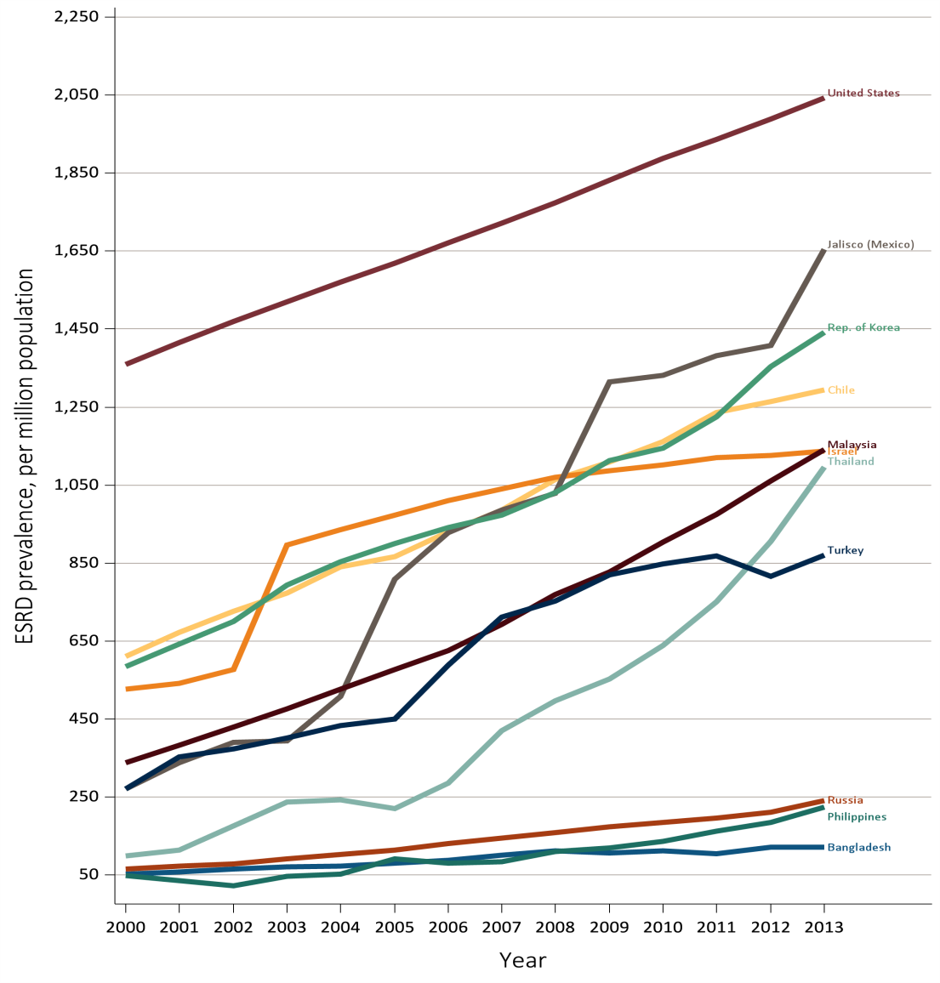
Figure 13.11 Trends in the prevalence of treated ESRD, per million population,
^{by country, 2000-2013}
Ten countries having the highest % rise in ESRD prevalence from 2000/01 to 2012/13, plus the U.S.
Data source: Special analyses, USRDS ESRD Database. ESRD prevalence is unadjusted. Israel includes dialysis patients only from 2000-2002. U.S. is shown for comparison purposes. Abbreviations: ESRD, end-stage renal disease.

Slide 27
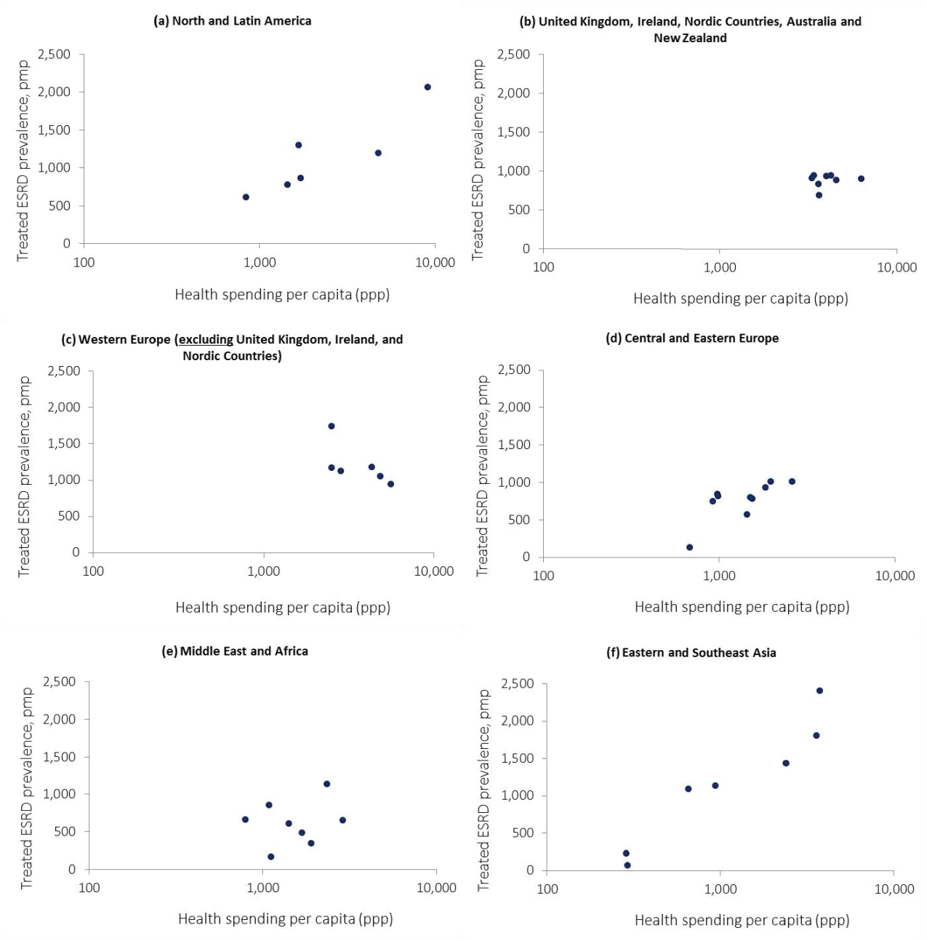
Figure 13.12 Prevalence of treated ESRD, per million population, and health spending per capita (PPP), by region, 2013
Data source: Special analyses, USRDS ESRD Database & World Health Organization Global Health Expenditure database. Data presented only for countries from which relevant information was available. ESRD prevalence is unadjusted and was from 2013 for all countries except Bahrain for which it was from 2011 and Ukraine for which it was from 2012. aCentral & Eastern Europe: Hungary, Romania, Czech Republic, Poland, Bosnia and Herzegovina, Serbia, Slovenia, Russian Federation, Turkey; Western Europe (except. UK, Ireland, & Nordic countries): France, Belgium (French-speaking), Belgium (Dutch-speaking), Spain, Portugal, Greece, Austria, Netherlands; UK, Ireland, Nordic Countries & ANZ: United Kingdom, Ireland, Sweden, Norway, Finland, Denmark, Iceland, Australia, New Zealand; North & Latin America: Argentina, Uruguay, Colombia, Brazil, Mexico (Jalisco), United States, Canada; Eastern & Southeast Asia: South Korea, Malaysia, Singapore, Thailand, Indonesia, Philippines, Japan; Middle East & Africa: Bahrain, Israel, Iran, Qatar, Saudi Arabia, South Africa. Abbreviations: ESRD, end-stage renal disease; PPP, purchasing power parity; pmp, per million population.

Slide 28
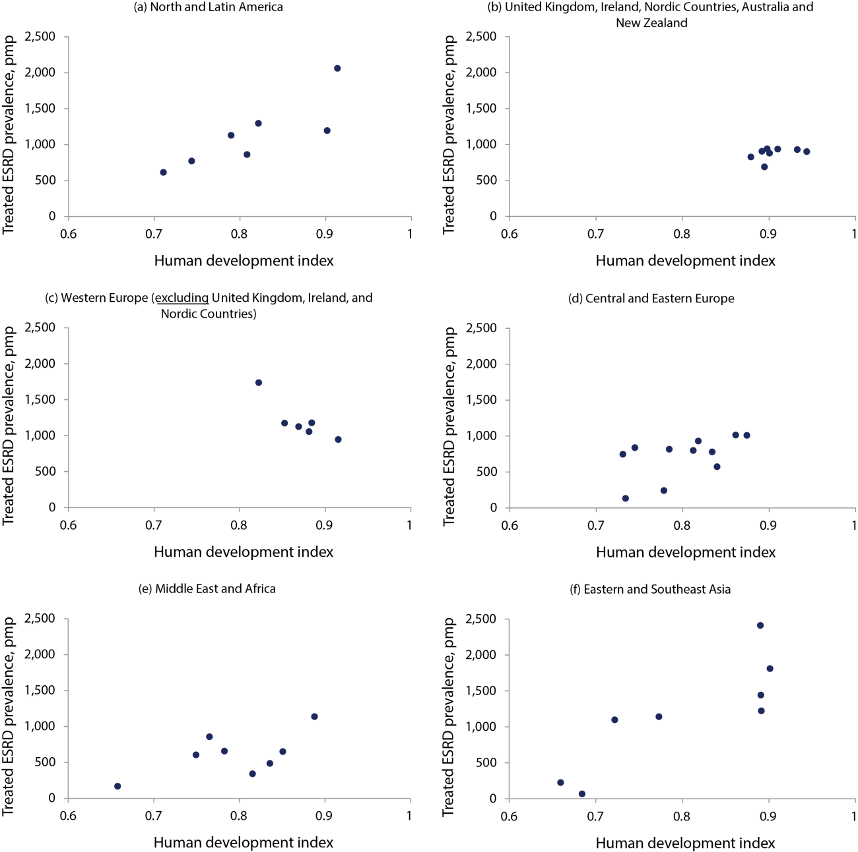
Figure 13.13 Prevalence of treated ESRD, per million population, and human development index, by region, 2013
Data source: Special analyses, USRDS ESRD Database & United Nations Development Programme. Data presented only for countries from which relevant information was available. ESRD prevalence is unadjusted and was from 2013 for all countries except Bahrain for which it was from 2011 and Ukraine for which it was from 2012. aCentral & Eastern Europe: Hungary, Romania, Czech Republic, Poland, Bosnia and Herzegovina, Serbia, Slovenia, Russian Federation, Turkey; Western Europe (except. UK, Ireland, & Nordic countries): France, Belgium (French-speaking), Belgium (Dutch-speaking), Spain, Portugal, Greece, Austria, Netherlands; UK, Ireland, Nordic Countries & ANZ: United Kingdom, Ireland, Sweden, Norway, Finland, Denmark, Iceland, Australia, New Zealand; North & Latin America: Argentina, Uruguay, Colombia, Brazil, Mexico (Jalisco), United States, Canada; Eastern & Southeast Asia: South Korea, Malaysia, Singapore, Thailand, Indonesia, Philippines, Japan; Middle East & Africa: Bahrain, Israel, Iran, Qatar, Saudi Arabia, South Africa. Abbreviations: ESRD, end-stage renal disease; pmp, per million population.

Slide 29
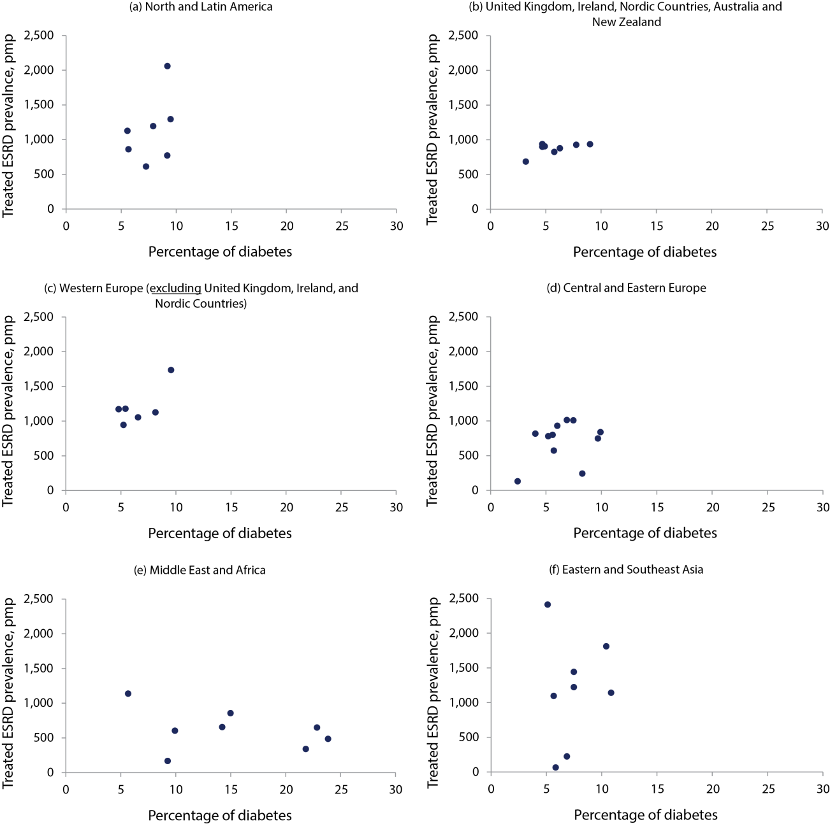
Figure 13.14 Prevalence of treated ESRD, per million population, and percentage of diabetes, by region, 2013
Data source: Special analyses, USRDS ESRD Database & International Diabetes Federation, Diabetes Atlas. Data presented only for countries from which relevant information was available. ESRD prevalence is unadjusted and was from 2013 for all countries except Bahrain for which it was from 2011 and Ukraine for which it was from 2012. Diabetes percentage refers to the percentage of people ages 20-79 who have type 1 or type 2 diabetes. aCentral & Eastern Europe: Hungary, Romania, Czech Republic, Poland, Bosnia and Herzegovina, Serbia, Slovenia, Russian Federation, Turkey; Western Europe (except. UK, Ireland, & Nordic countries): France, Belgium (French-speaking), Belgium (Dutch-speaking), Spain, Portugal, Greece, Austria, Netherlands; UK, Ireland, Nordic Countries & ANZ: United Kingdom, Ireland, Sweden, Norway, Finland, Denmark, Iceland, Australia, New Zealand; North & Latin America: Argentina, Uruguay, Colombia, Brazil, Mexico (Jalisco), United States, Canada; Eastern & Southeast Asia: South Korea, Malaysia, Singapore, Thailand, Indonesia, Philippines, Japan; Middle East & Africa: Bahrain, Israel, Iran, Qatar, Saudi Arabia, South Africa. Abbreviations: ESRD, end-stage renal disease; pmp, per million population.

Slide 30
Table 13.4 Health development indicators and the prevalence of treated ESRD
across countries, 2013
Region | Country | Health spending per capita | Human Development Index | Percentage of diabetes | Prevalence of treated ESRD, pmp
Central & Eastern Europe | Bosnia and Herzegovina | 928 | 0.73 | 9.7 | 747
 | Croatia | 1517 | 0.81 | 5.6 | 800
 | Czech Republic | 1982 | 0.86 | 6.9 | 1013
 | Estonia | 1453 | 0.84 | 5.7 | 572
 | Hungary | 1839 | 0.82 | 6.0 | 930
 | Poland | 1551 | 0.83 | 5.2 | 780
 | Romania | 988 | 0.78 | 4.0 | 817
 | Russia | NA | 0.78 | 8.3 | 241
 | Serbia | 987 | 0.74 | 9.9 | 839
 | Slovenia | 2595 | 0.87 | 7.5 | 1008
 | Ukraine | 687 | 0.73 | 2.5 | 131
Eastern & Southeast Asia | Hong Kong | NA | 0.89 | 7.5 | 1223
 | Indonesia | 293 | 0.68 | 5.8 | 66
 | Japan | 3741 | 0.89 | 5.1 | 2411
 | Republic of Korea | 2398 | 0.89 | 7.5 | 1442
 | Malaysia | 938 | 0.77 | 10.9 | 1140
 | Philippines | 287 | 0.66 | 6.9 | 224
 | Singapore | 3578 | 0.90 | 10.4 | 1809
 | Thailand | 658 | 0.72 | 5.7 | 1097
Middle East & Africa | Bahrain | 1900 | 0.82 | 21.8 | 340
 | Iran | 1414 | 0.75 | 9.9 | 603
 | Israel | 2357 | 0.89 | 5.7 | 1137
 | Lebanon | 1092 | 0.77 | 15.0 | 855
 | Oman | 796 | 0.78 | 14.2 | 656
 | Qatar | 2882 | 0.85 | 22.9 | 649
 | Saudi Arabia | 1681 | 0.84 | 23.9 | 486
 | South Africa | 1121 | 0.66 | 9.3 | 167
^{(Continue} ^{on the next slide)}

Slide 31
Table 13.4 Health development indicators and the prevalence of treated ESRD
across countries, 2013 (Continued)
Region | Country | Health spending per capita | Human Development Index | Percentage of diabetes | Prevalence of treated ESRD, pmp
North & Latin America | Argentina | 1725 | 0.81 | 5.7 | 860
 | Brazil | 1452 | 0.74 | 9.2 | 771
 | Canada | 4759 | 0.90 | 7.9 | 1193
 | Chile | 1678 | 0.82 | 9.5 | 1294
 | Colombia | 843 | 0.71 | 7.3 | 611
 | United States | 9146 | 0.91 | 9.2 | 2043
 | Uruguay | 1715 | 0.79 | 5.6 | 1127
UK, Ireland, Nordic European Union Countries, & Australia /New Zealand | Australia | 3997 | 0.93 | 7.8 | 928
 | Denmark | 4552 | 0.90 | 6.3 | 877
 | Finland | 3604 | 0.88 | 5.8 | 826
 | Iceland | 3646 | 0.89 | 3.2 | 686
 | New Zealand | 3405 | 0.91 | 9.0 | 936
 | Norway | 6308 | 0.94 | 4.7 | 901
 | Sweden | 4244 | 0.90 | 4.7 | 940
 | United Kingdom | 3311 | 0.89 | 4.9 | 905
Western Europe | Austria | 4885 | 0.88 | 6.6 | 1054
 | France | 4334 | 0.88 | 5.4 | 1177
 | Greece | 2513 | 0.85 | 4.8 | 1172
 | Netherlands | 5601 | 0.92 | 5.2 | 945
 | Portugal | 2508 | 0.82 | 9.6 | 1737
 | Spain | 2846 | 0.87 | 8.2 | 1126
Data source: Special analyses, USRDS ESRD Database & World Health Organization Global Health Expenditure database, United Nations Development Programme, International Diabetes Federation, Diabetes Atlas. Data presented only for countries from which relevant information was available. ESRD prevalence is unadjusted and reflects the most recent available prevalence since 2010. Diabetes percentage refers to the percentage of people ages 20-79 who have type 1 or type 2 diabetes. Abbreviations: ESRD, end-stage renal disease; PPP, purchasing power parity; pmp, per million population.

Slide 32
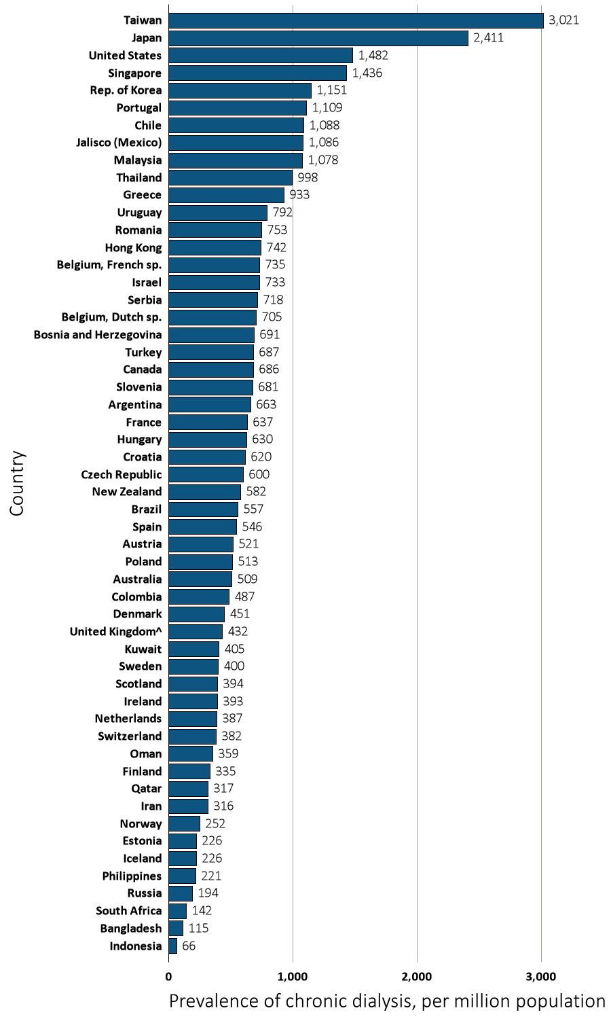
Figure 13.15 Prevalence of dialysis, per million population, by country, 2013
Data source: Special analyses, USRDS ESRD Database. The prevalence is unadjusted and reflects prevalence at the end of 2013. ^United Kingdom: England, Wales, Northern Ireland (Scotland data reported separately). Data for Indonesia represent the West Java region. Data for Spain include 18 of 19 regions. Data for France include 22 regions. Data for Belgium do not include patients younger than 20. Abbreviations: sp., speaking.

Slide 33
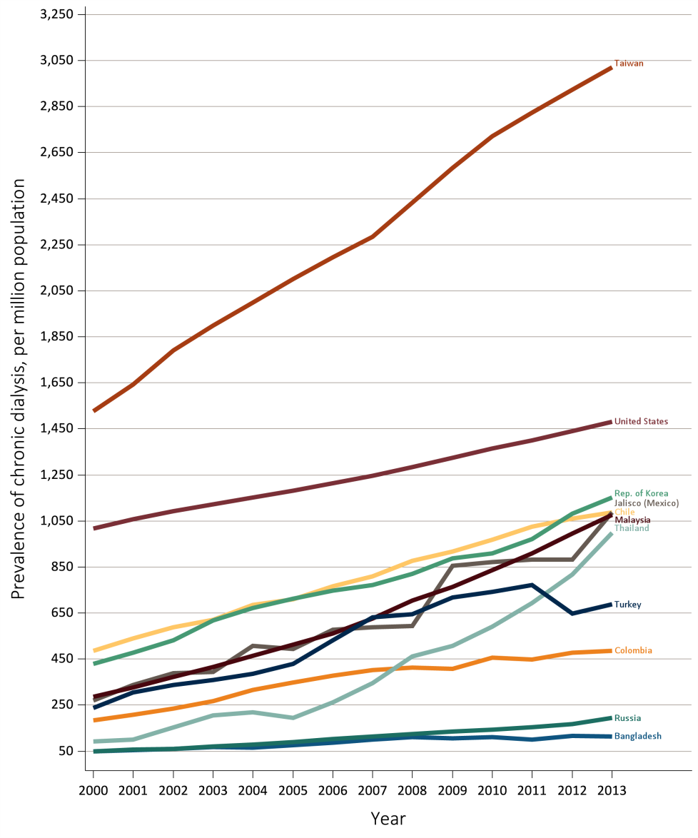
Figure 13.16 Trends in the prevalence of dialysis, per million population,
by country, 2000-2013
Ten countries having the highest % rise in dialysis prevalence from 2000/01 to 2012/13, plus the U.S.
Data source: Special analyses, USRDS ESRD Database. The prevalence is unadjusted and reflects prevalence of dialysis at the end of each year. U.S. is shown for comparison purposes. Abbreviations: ESRD, end-stage renal disease.

Slide 34
Table 13.5 Trends in the prevalence of dialysis, per million population,
by country, 2000-2013
Country | 2000 | 2001 | 2002 | 2003 | 2004 | 2005 | 2006 | 2007 | 2008 | 2009 | 2010 | 2011 | 2012 | 2013 | % change from 2000/01 to 2012/13
Argentina | . | . | . | . | 550.3 | 578.7 | 598.0 | 615.4 | 623.4 | 634.1 | 636.9 | 644.0 | 655.1 | 662.7 | .
Australia | 334.7 | 353.0 | 370.3 | 388.5 | 398.2 | 424.9 | 447.1 | 462.9 | 478.8 | 482.6 | 486.3 | 494.9 | 505.1 | 509.1 | 47.5
Austria | 372.3 | 386.2 | 394.2 | 412.1 | 441.8 | 461.4 | 469.6 | 477.7 | 487.9 | 505.9 | 507.8 | 503.2 | 510.2 | 521.1 | 36
Bahrain | . | . | . | . | . | . | . | . | 212.4 | 221.5 | 196.8 | 250.2 | . | . | .
Bangladesh | 48.6 | 54.6 | 60.9 | 68.0 | 64.7 | 75.7 | 87.3 | 99.3 | 112.1 | 104.7 | 109.7 | 101.0 | 117.5 | 114.7 | 125
Belgium, Dutch sp. | 440.6 | 467.9 | 501.3 | 518.7 | 549.3 | 589.0 | 609.9 | 624.3 | 644.4 | 674.6 | 689.2 | 694.8 | 699.8 | 705.4 | 54.7
Belgium, French sp. | . | 506.3 | 523.4 | 555.2 | 594.3 | 611.8 | 637.8 | 657.6 | 673.0 | 663.6 | 682.8 | 689.6 | 713.2 | 735.1 | 43
Bosnia and Herzegovina | . | . | . | 450.7 | 455.6 | 490.8 | 521.1 | 569.9 | 596.5 | 602.8 | 630.7 | 662.2 | 666.8 | 690.7 | .
Brazil | . | . | . | 338.1 | 367.5 | 388.9 | 398.3 | 466.0 | 408.5 | 475.8 | 467.1 | 494.4 | 503.9 | 556.7 | .
Canada | 487.9 | 521.9 | 551.5 | 565.4 | 591.1 | 613.2 | 629.9 | 643.1 | 652.4 | 667.2 | 670.6 | 680.3 | 684.1 | 685.9 | 35.7
Chile | 484.4 | 540.5 | 587.1 | 621.2 | 684.6 | 708.4 | 764.9 | 810.2 | 876.3 | 917.9 | 969.6 | 1025.6 | 1059.9 | 1088.2 | 109.6
Colombia | 184.4 | 208.8 | 236.2 | 267.4 | 315.5 | 348.6 | 377.6 | 403.1 | 412.7 | 408.2 | 455.4 | 447.9 | 478.7 | 486.5 | 145.5
Croatia | 529.7 | 556.9 | 581.2 | 655.4 | 652.9 | 669.2 | . | . | . | . | . | . | 651.7 | 620.3 | 17.1
Czech Republic | 382.4 | 409.5 | 428.4 | 424.6 | 440.7 | 452.3 | 461.9 | 499.9 | 538.1 | 548.7 | 599.8 | 584.1 | . | 600.3 | 51.6
Denmark | 385.8 | 423.7 | 440.8 | 452.5 | 457.7 | 460.9 | 463.8 | 498.4 | 490.0 | 486.8 | 470.0 | 461.0 | 461.0 | 451.4 | 12.7
Estonia | . | . | . | . | . | . | . | . | . | . | . | . | . | 226.1 | .
Finland | 230.3 | 243.4 | 257.3 | 272.6 | 280.0 | 297.6 | 292.4 | 302.0 | 319.8 | 323.3 | 329.3 | 331.5 | 327.9 | 335.0 | 39.9
France | . | . | . | . | . | 526.9 | 554.0 | 546.7 | 567.4 | 572.1 | 590.4 | 605.2 | 616.9 | 637.2 | .
Greece | 660.0 | 674.1 | 691.3 | 718.9 | 752.4 | 776.7 | 793.6 | 811.1 | 824.0 | 851.5 | 867.7 | 882.4 | 904.9 | 933.1 | 37.8
Hong Kong | . | . | 556.1 | 563.3 | 566.4 | 582.9 | 593.2 | 611.0 | 624.6 | 647.3 | 661.6 | 681.5 | 709.5 | 742.4 | .
Hungary | . | . | . | . | . | . | . | . | 578.1 | 605.3 | 620.0 | 626.2 | 632.8 | 630.4 | .
Iceland | 138.7 | 175.5 | 198.2 | 234.9 | 229.4 | 195.5 | 167.9 | 199.7 | 201.6 | 191.5 | 223.2 | 250.8 | 237.0 | 225.5 | 47.2
Indonesia | . | . | . | . | . | . | . | . | . | 27.9 | 37.3 | 40.1 | 50.6 | 65.9 | .
Iran | . | . | . | . | . | . | . | . | 245.0 | 282.1 | 290.7 | 299.2 | 307.3 | 316.4 | .
Ireland | . | . | . | . | . | . | . | . | . | 366.8 | 386.4 | 386.5 | 391.9 | 392.8 | .
Israel | 526.0 | 542.0 | 577.7 | 599.1 | 621.8 | 636.7 | 652.4 | 668.4 | 684.8 | 703.8 | 721.2 | 728.3 | 730.2 | 732.6 | 37
Italy | . | . | . | . | . | . | . | . | . | . | 792.7 | . | . | . | .
Jalisco (Mexico) | 270.3 | 337.9 | 389.5 | 394.4 | 507.6 | 493.2 | 576.9 | 586.9 | 593.4 | 856.1 | 872.1 | 881.1 | 883.0 | 1086.1 | 223.8
Japan | 1616.2 | 1640.3 | 1727.0 | 1795.2 | 1850.9 | 1879.8 | 1954.5 | 2058.1 | 2126.0 | 2205.4 | 2277.4 | 2313.8 | 2365.2 | 2411.1 | 46.7
Rep. of Korea | 427.8 | 477.5 | 530.2 | 617.6 | 670.8 | 711.7 | 746.0 | 770.6 | 818.9 | 888.7 | 910.2 | 972.4 | 1081.0 | 1151.0 | 146.5
Kuwait | . | . | . | . | . | . | . | . | . | . | . | . | 346.6 | 404.8 | .
Lebanon | . | . | . | . | . | . | . | . | . | . | . | . | 665.4 | . | .
Malaysia | 285.4 | 326.9 | 371.3 | 416.7 | 464.6 | 513.0 | 560.8 | 627.1 | 703.8 | 762.7 | 836.7 | 908.9 | 996.1 | 1077.5 | 238.7
^{(Continue} ^{on the next slide)}

Slide 35
Table 13.5 Trends in the prevalence of dialysis, per million population,
by country, 2000-2013 (Continued)
Country | 2000 | 2001 | 2002 | 2003 | 2004 | 2005 | 2006 | 2007 | 2008 | 2009 | 2010 | 2011 | 2012 | 2013 | % change from 2000/01 to 2012/13
Morelos (Mexico) | . | . | . | . | . | . | . | 835.9 | 905.0 | 946.4 | . | . | . | . | .
Netherlands | 302.5 | 310.4 | 315.0 | 320.5 | 326.7 | 336.3 | 353.4 | 356.3 | 369.5 | 385.0 | 385.1 | 385.2 | 385.1 | 387.2 | 26
New Zealand | 346.0 | 378.3 | 406.2 | 427.8 | 435.2 | 454.3 | 477.5 | 489.8 | 494.4 | 530.1 | 548.9 | 545.6 | 559.7 | 581.7 | 57.6
Norway | 143.6 | 160.2 | 172.5 | 179.4 | 195.6 | 207.9 | 216.5 | 232.3 | 243.7 | 252.0 | 249.9 | 246.1 | 248.9 | 251.8 | 64.8
Oman | . | . | . | . | . | . | . | . | 231.0 | 258.3 | 322.1 | 347.8 | 382.8 | 358.5 | .
Philippines | . | . | 20.1 | 46.0 | 61.2 | 86.5 | 75.8 | 79.4 | 104.6 | 114.0 | 132.9 | 159.4 | 181.8 | 221.0 | .
Poland | . | . | . | . | . | . | . | . | 417.5 | 432.8 | 446.3 | 466.1 | 483.2 | 513.2 | .
Portugal | . | . | . | . | . | . | . | . | 922.6 | 960.5 | 1023.7 | 1052.2 | 1068.2 | 1108.6 | .
Qatar | . | . | . | . | . | . | . | . | . | . | 246.6 | 254.5 | 271.9 | 316.7 | .
Romania | . | . | . | . | . | 239.5 | 285.0 | 346.2 | 393.8 | 518.0 | 581.1 | 642.3 | 708.0 | 752.5 | .
Russia | 48.3 | 55.7 | 60.6 | 69.0 | 79.1 | 90.4 | 101.6 | . | 124.4 | 135.4 | 144.3 | 154.8 | 168.3 | 193.6 | 248
Saudi Arabia | . | . | . | . | . | . | . | . | 460.7 | 474.5 | 465.5 | 492.2 | 499.4 | . | .
Scotland | 326.9 | 334.8 | 354.3 | 367.2 | 379.5 | 399.0 | 414.1 | 424.4 | 415.2 | 418.2 | 418.8 | 410.6 | 407.4 | 393.8 | 21.1
Serbia | . | . | . | . | . | . | . | . | . | . | . | 657.8 | 688.3 | 718.1 | .
Singapore | 841.9 | 897.1 | 944.9 | 979.6 | 998.1 | 1028.1 | 1070.5 | 1101.0 | 1145.9 | 1173.6 | 1218.5 | 1291.8 | 1373.6 | 1436.1 | 61.6
Slovenia | . | . | . | . | . | . | . | . | . | 716.3 | 703.9 | 689.3 | 689.8 | 681.1 | .
South Africa | . | . | . | . | . | . | . | . | . | . | . | . | 132.9 | 142.2 | .
Spain | . | . | . | . | 576.9 | 545.6 | 515.6 | 503.6 | 489.8 | 461.5 | 579.9 | 537.1 | 529.6 | 545.9 | .
Sweden | 338.9 | 353.1 | 367.3 | 367.0 | 378.5 | 381.3 | 396.1 | 397.1 | 388.6 | 392.8 | 403.1 | 409.7 | 402.1 | 400.0 | 15.9
Switzerland | . | . | . | . | . | . | . | . | . | . | . | . | . | 381.6 | .
Taiwan | 1526.3 | 1643.7 | 1792.2 | 1899.8 | 1999.2 | 2101.4 | 2196.8 | 2285.1 | 2432.0 | 2585.1 | 2720.5 | 2823.1 | 2923.1 | 3020.5 | 87.5
Thailand | 93.0 | 98.9 | . | 205.9 | 218.5 | 195.4 | 261.2 | 346.5 | 460.7 | 506.8 | 589.5 | 693.8 | 817.0 | 998.2 | 845.9
Turkey | 237.9 | 306.1 | 337.1 | 359.6 | 386.3 | 430.0 | 530.8 | 631.5 | 643.7 | 717.6 | 742.9 | 772.8 | 646.6 | 687.1 | 145.2
United Kingdom^ | . | . | . | . | 335.2 | 329.0 | 352.7 | 391.8 | 402.8 | 415.9 | 419.3 | 426.7 | 430.4 | 432.2 | .
United States | 1018.3 | 1056.4 | 1091.6 | 1123.1 | 1151.6 | 1181.3 | 1214.7 | 1247.5 | 1283.2 | 1324.5 | 1365.5 | 1399.4 | 1439.1 | 1481.6 | 40.8
Uruguay | 644.1 | 662.4 | 687.2 | 711.2 | 723.2 | 717.2 | 716.9 | 729.3 | 760.9 | 745.9 | 749.0 | 762.0 | 757.1 | 791.8 | 18.6
Data source: Special analyses, USRDS ESRD Database. Data presented only for countries from which relevant information was available. The prevalence is unadjusted and reflects prevalence of dialysis at the end of each year. ^United Kingdom: England, Wales, & Northern Ireland (Scotland data reported separately). Data for France include 15 regions in 2006, 18 in 2007, 20 in 2008, and 22 in 2009-2013. Data for Belgium do not include patients younger than 20. Data for Spain include 18 of 19 regions. ª% change is calculated as the percent difference between the average prevalence in 2012 and 2013 and the average in 2000 and 2001. Abbreviations: sp., speaking; . signifies data not reported.

Slide 36
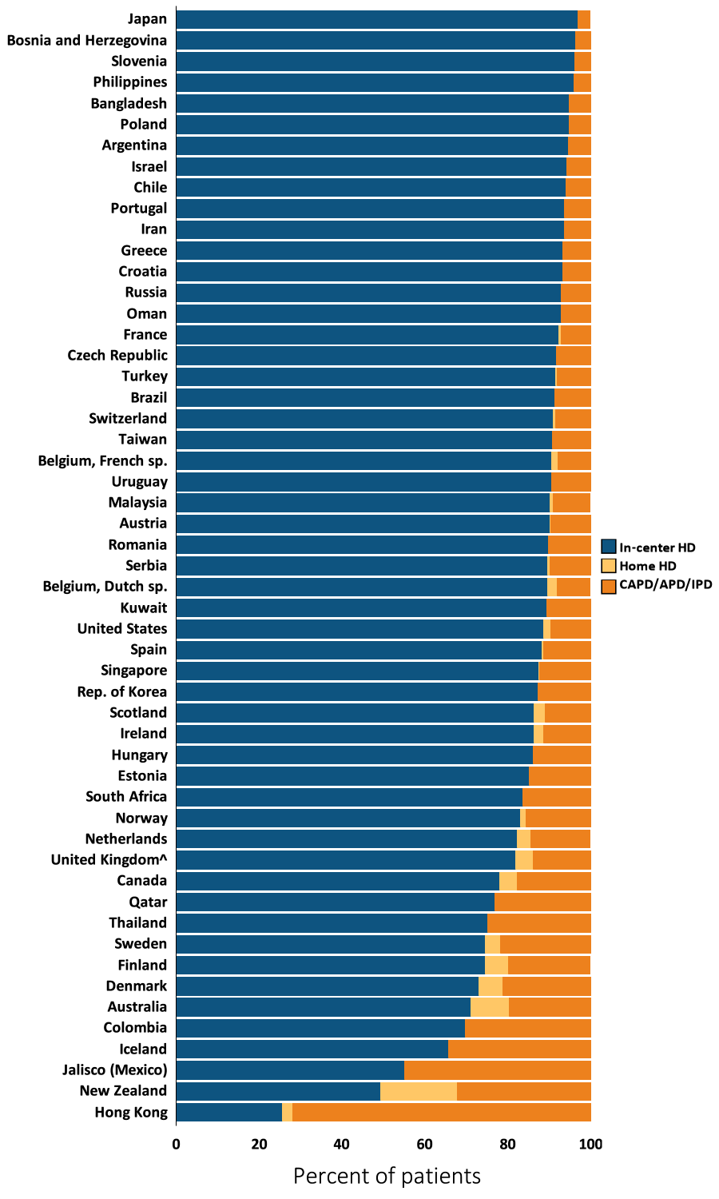
Figure 13.17 Distribution of the percentage of prevalent dialysis patients using in-center HD, home HD, or peritoneal (CAPD/APD/IPD), 2013
Data source: Special analyses, USRDS ESRD Database. Denominator is calculated as the sum of patients receiving HD, PD, or Home HD; does not include patients with other/unknown modality. ^United Kingdom: England, Wales, & Northern Ireland (Scotland data reported separately). Data for Spain include 18 of 19 regions. Data for France include 22 regions. Data for Belgium do not include patients younger than 20. Abbreviations: CAPD, continuous ambulatory peritoneal dialysis; APD, automated peritoneal dialysis; IPD, intermittent peritoneal dialysis; ESRD, end-stage renal disease; HD, hemodialysis; PD, peritoneal dialysis; sp., speaking.

Slide 37
Table 13.6 Distribution of the percentage of prevalent dialysis patients using in-center HD, home HD, or peritoneal dialysis (CAPD/APD/IPD), 2000-2013
 | In-center HD
Country | 2000 | 2001 | 2002 | 2003 | 2004 | 2005 | 2006 | 2007 | 2008 | 2009 | 2010 | 2011 | 2012 | 2013
Argentina | . | . | . | . | 95.6 | 96.0 | 96.0 | 96.1 | 96.0 | 96.0 | 95.8 | 95.1 | 94.8 | 94.6
Australia | 61.3 | 62.3 | 64.7 | 66.1 | 67.6 | 68.9 | 68.2 | 68.3 | 68.6 | 69.6 | 71.3 | 72.2 | 71.1 | 71.1
Austria | 91.6 | 91.7 | 92.0 | 92.0 | 92.3 | 92.1 | 90.8 | 91.2 | 91.0 | 91.0 | 91.1 | 91.6 | 90.9 | 90.3
Bahrain | . | . | . | . | . | . | . | . | 95.7 | 95.8 | 95.5 | 95.3 | 88.4 | .
Bangladesh | 99.1 | 99.1 | 99.1 | 99.0 | 98.8 | 98.6 | 99.6 | 98.4 | 98.3 | 98.2 | 97.5 | 96.2 | 95.9 | 94.9
Belgium, Dutch sp. | 91.9 | 90.1 | 89.7 | 89.5 | 88.5 | 88.8 | 89.1 | 89.2 | 89.7 | 88.9 | 89.5 | 89.2 | 89.2 | 89.7
Belgium, French sp. | . | 90.6 | 90.3 | 90.3 | 89.8 | 89.5 | 89.2 | 90.5 | 90.7 | 90.4 | 89.9 | 90.2 | 90.4 | 90.7
Bosnia and Herzegovina | . | . | . | 96.6 | 96.2 | 95.7 | 95.3 | 95.2 | 95.1 | 94.9 | 95.2 | 96.0 | 96.5 | 96.5
Brazil | . | . | . | 89.2 | 89.0 | 90.7 | 90.8 | 89.4 | 89.6 | 92.3 | 90.6 | 91.6 | 90.8 | 91.4
Canada | 76.3 | 77.6 | 78.7 | 79.4 | 79.1 | 78.9 | 78.9 | 78.6 | 78.4 | 78.4 | 78.5 | 78.9 | 78.4 | 78.1
Chile | 96.3 | 96.0 | 95.3 | 94.3 | 94.0 | 94.3 | 95.0 | 95.2 | 95.3 | 95.3 | 95.1 | 94.6 | 94.5 | 94.0
Colombia | . | . | . | . | 63.3 | 62.4 | 63.9 | 63.4 | 68.0 | 68.2 | 68.7 | 69.1 | 69.4 | 69.9
Croatia | 94.7 | 93.3 | 91.5 | 92.0 | 91.1 | 90.8 | 91.6 | 92.8 | 91.8 | 91.0 | 91.5 | 92.1 | 93.5 | 93.3
Czech Republic | 93.3 | 92.4 | 92.8 | 92.6 | 92.5 | 92.5 | 92.4 | 92.3 | 91.8 | 92.0 | 92.1 | 91.7 | . | 91.8
Denmark | 73.4 | 72.8 | 74.3 | 72.8 | 73.0 | 72.2 | 72.0 | 71.8 | 72.9 | 73.4 | 73.7 | 75.0 | 74.7 | 73.0
Estonia | . | . | . | . | . | . | . | . | . | . | . | . | . | 85.2
Finland | 75.8 | 77.8 | 78.2 | 75.5 | 75.6 | 75.5 | 76.0 | 75.8 | 74.3 | 75.0 | 77.1 | 77.4 | 76.2 | 74.6
France | . | . | . | . | . | 85.2 | 85.4 | 87.4 | 87.8 | 91.9 | 92.1 | 92.5 | 92.5 | 92.3
Greece | 89.4 | 89.9 | 90.0 | 90.3 | 90.6 | 91.0 | 91.5 | 91.7 | 91.7 | 92.0 | 92.3 | 92.7 | 93.4 | 93.4
Hong Kong | . | . | 17.9 | 17.4 | 17.9 | 17.7 | 18.8 | 19.8 | 20.4 | 21.5 | 23.5 | 24.4 | 25.0 | 25.6
Hungary | . | . | . | . | . | . | . | . | 88.3 | 87.2 | 86.5 | 85.8 | 85.7 | 86.1
Iceland | 71.8 | 70.0 | 66.7 | 66.2 | 58.8 | 65.5 | 70.6 | 72.1 | 76.6 | 86.9 | 83.1 | 80.0 | 72.4 | 65.8
Iran | . | . | . | . | . | . | . | . | 93.8 | 94.5 | 93.5 | 93.1 | 93.4 | 93.7
Ireland | . | . | . | . | . | . | . | . | . | 88.6 | 88.3 | 88.1 | 86.8 | 86.3
Israel | 87.5 | 88.8 | 84.7 | 88.5 | 89.0 | 90.9 | 91.9 | 92.9 | 93.6 | 93.3 | 93.8 | 94.1 | 94.3 | 94.3
Italy | . | . | . | . | . | . | . | . | . | . | 90.0 | . | . | .
Jalisco (Mexico) | 17.0 | 17.0 | 18.0 | 20.0 | 30.1 | 28.3 | 29.5 | 34.2 | 40.4 | 41.5 | 48.7 | 50.6 | 49.8 | 55.2
Japan | 95.9 | 96.1 | 96.2 | 96.5 | 96.6 | 96.6 | 96.8 | 96.7 | 96.8 | 96.7 | 96.7 | 96.8 | 96.9 | 96.9
^{(Continue} ^{on the next slide)}

Slide 38
Table 13.6 Distribution of the percentage of prevalent dialysis patients using in-center HD, home HD, or peritoneal dialysis (CAPD/APD/IPD), 2000-2013 (Continued)
 | In-center HD
Country | 2000 | 2001 | 2002 | 2003 | 2004 | 2005 | 2006 | 2007 | 2008 | 2009 | 2010 | 2011 | 2012 | 2013
Rep. of Korea | 77.2 | 76.2 | 77.8 | 77.4 | 77.0 | 77.7 | 78.4 | 80.2 | 81.0 | 83.1 | 84.4 | 84.7 | 86.5 | 87.4
Kuwait | . | . | . | . | . | . | . | . | . | . | . | . | 89.7 | 89.5
Lebanon | . | . | . | . | . | . | . | . | . | . | . | . | 96.0 | .
Malaysia | 86.7 | 87.3 | 87.5 | 88.1 | 89.2 | 90.1 | 90.2 | 89.9 | 90.0 | 90.3 | 90.6 | 90.8 | 90.4 | 90.3
Morelos (Mexico) | . | . | . | . | . | . | . | 40.6 | 43.2 | 42.4 | . | . | . | .
Netherlands | 67.6 | 66.9 | 68.3 | 69.5 | 72.2 | 73.4 | 74.8 | 76.0 | 77.4 | 79.1 | 79.5 | 81.4 | 81.6 | 82.4
New Zealand | 34.9 | 37.6 | 37.5 | 41.2 | 43.3 | 45.9 | 45.5 | 48.2 | 48.1 | 48.4 | 47.4 | 48.6 | 49.3 | 49.4
Norway | 81.2 | 86.2 | 84.0 | 83.6 | 82.9 | 83.2 | 80.5 | 80.6 | 83.4 | 80.7 | 81.3 | 84.2 | 83.2 | 83.2
Oman | . | . | . | . | . | . | . | . | 95.7 | 97.1 | 95.9 | 96.0 | 95.0 | 92.9
Philippines | . | . | 91.2 | 100.0 | 85.5 | 87.9 | 94.5 | 87.3 | 93.3 | 95.6 | 95.9 | 96.4 | 96.4 | 96.1
Poland | . | . | . | . | . | . | . | . | 93.1 | 93.3 | 93.5 | 94.1 | 94.0 | 94.8
Portugal | . | . | . | . | . | . | . | . | 94.8 | 94.4 | 93.9 | 93.7 | 93.4 | 93.7
Qatar | . | . | . | . | . | . | . | . | . | . | 70.9 | 73.5 | 77.4 | 77.0
Romania | . | . | . | . | . | 81.9 | 80.6 | 81.8 | 82.8 | 84.5 | 86.4 | 87.7 | 88.8 | 89.9
Russia | 93.1 | 93.4 | 93.5 | 92.5 | 91.9 | 91.5 | 91.0 | . | 91.0 | 91.3 | 91.4 | 91.6 | 92.3 | 92.9
Saudi Arabia | . | . | . | . | . | . | . | . | 92.2 | 90.6 | 90.5 | 90.7 | 90.6 | .
Scotland | 68.7 | 73.0 | 75.6 | 77.4 | 77.4 | 77.8 | 79.0 | 80.7 | 82.6 | 83.7 | 84.8 | 85.3 | 85.6 | 86.4
Serbia | . | . | . | . | . | . | . | . | . | . | . | 90.1 | 90.5 | 89.7
Singapore | 84.3 | 83.5 | 79.4 | 79.6 | 79.2 | 80.3 | 81.1 | 82.5 | 85.6 | 86.3 | 87.4 | 87.2 | 87.9 | 87.6
Slovenia | . | . | . | . | . | . | . | . | . | 95.6 | 96.5 | 96.6 | 96.8 | 96.3
South Africa | . | . | . | . | . | . | . | . | . | . | . | . | 82.7 | 83.6
Spain | . | . | . | . | 88.6 | 90.6 | 90.1 | 89.4 | 90.6 | 90.6 | 89.8 | 89.2 | 88.7 | 88.3
Sweden | 72.7 | 73.0 | 73.5 | 74.2 | 74.6 | 75.8 | 75.5 | 73.0 | 73.3 | 73.7 | 74.7 | 75.6 | 76.0 | 74.6
Switzerland | . | . | . | . | . | . | . | . | . | . | . | . | . | 91.1
Taiwan | 94.2 | 93.7 | 93.9 | 93.5 | 93.5 | 93.0 | 92.4 | 91.5 | 90.7 | 90.7 | 90.6 | 90.5 | 90.7 | 90.8
Thailand | 82.9 | 84.5 | . | 92.3 | 93.2 | 93.9 | 95.8 | 94.5 | 90.5 | 84.1 | 81.9 | 78.6 | 76.9 | 75.2
Turkey | 87.3 | 89.0 | 86.9 | 87.5 | 88.2 | 87.9 | 88.7 | 88.1 | 87.4 | 89.6 | 90.4 | 91.8 | 90.4 | 91.6
United Kingdom^ | . | . | . | . | 73.8 | 76.3 | 78.6 | 78.9 | 81.1 | 81.6 | 81.9 | 81.9 | 81.5 | 82.0
United States | 89.7 | 90.2 | 90.5 | 90.7 | 91.1 | 91.1 | 91.3 | 91.4 | 91.5 | 91.3 | 90.9 | 90.3 | 89.3 | 88.7
Uruguay | 94.4 | 94.9 | 93.7 | 93.0 | 92.3 | 92.3 | 92.6 | 90.6 | 91.1 | 90.8 | 90.1 | 90.1 | 90.3 | 90.6
^{(Continue} ^{on the next slide)}

Slide 39
Table 13.6 Distribution of the percentage of prevalent dialysis patients using in-center HD, home HD, or peritoneal dialysis (CAPD/APD/IPD), 2000-2013 (Continued)
 | (b) CAPD/APD/IPD
Country | 2000 | 2001 | 2002 | 2003 | 2004 | 2005 | 2006 | 2007 | 2008 | 2009 | 2010 | 2011 | 2012 | 2013
Argentina | . | . | . | . | 4.4 | 4.0 | 4.0 | 3.9 | 4.0 | 4.0 | 4.2 | 4.9 | 5.2 | 5.4
Australia | 27.1 | 26.4 | 24.6 | 23.9 | 22.4 | 21.5 | 22.1 | 22.0 | 22.0 | 21.0 | 19.5 | 18.8 | 19.5 | 19.6
Austria | 8.2 | 8.0 | 7.7 | 7.8 | 7.5 | 7.7 | 9.0 | 8.7 | 8.9 | 8.9 | 8.9 | 8.4 | 9.0 | 9.6
Bahrain | . | . | . | . | . | . | . | . | 4.3 | 4.2 | 4.5 | 4.7 | 11.6 | .
Bangladesh | 0.9 | 0.9 | 0.9 | 1.0 | 1.2 | 1.4 | 0.4 | 1.6 | 1.7 | 1.8 | 2.5 | 3.8 | 4.1 | 5.1
Belgium, Dutch sp. | 7.8 | 9.7 | 10.2 | 10.4 | 11.3 | 11.0 | 10.7 | 10.6 | 10.1 | 9.9 | 9.2 | 9.1 | 8.4 | 8.0
Belgium, French sp. | . | 8.3 | 8.7 | 8.5 | 9.0 | 9.3 | 9.5 | 8.3 | 8.0 | 8.4 | 8.7 | 8.2 | 8.1 | 7.8
Bosnia and Herzegovina | . | . | . | 3.4 | 3.8 | 4.3 | 4.7 | 4.7 | 4.9 | 5.0 | 4.8 | 4.0 | 3.5 | 3.5
Brazil | . | . | . | 10.8 | 11.0 | 9.3 | 9.2 | 10.6 | 10.4 | 7.7 | 9.4 | 8.4 | 9.2 | 8.6
Canada | 22.2 | 21.0 | 19.8 | 18.9 | 18.9 | 18.7 | 18.4 | 18.4 | 18.4 | 18.1 | 17.9 | 17.2 | 17.5 | 17.6
Chile | 3.7 | 4.0 | 4.7 | 5.7 | 6.0 | 5.6 | 5.0 | 4.8 | 4.7 | 4.7 | 4.9 | 5.4 | 5.5 | 6.0
Colombia | . | . | . | . | 36.7 | 37.6 | 36.1 | 36.6 | 32.0 | 31.8 | 31.3 | 30.9 | 30.6 | 30.1
Croatia | 5.3 | 6.7 | 8.5 | 8.0 | 8.9 | 9.2 | 8.4 | 7.2 | 8.2 | 9.0 | 8.5 | 7.9 | 6.5 | 6.7
Czech Republic | 6.7 | 7.5 | 7.2 | 7.4 | 7.5 | 7.5 | 7.6 | 7.7 | 8.2 | 8.0 | 7.9 | 8.3 | . | 8.2
Denmark | 26.1 | 26.5 | 24.7 | 25.7 | 24.7 | 24.8 | 23.9 | 24.5 | 22.9 | 21.6 | 20.8 | 19.5 | 19.7 | 21.2
Estonia | . | . | . | . | . | . | . | . | . | . | . | . | . | 14.8
Finland | 22.7 | 20.3 | 18.9 | 21.3 | 21.0 | 21.3 | 21.2 | 20.4 | 21.7 | 21.3 | 18.9 | 18.5 | 18.4 | 19.6
France | . | . | . | . | . | 12.2 | 12.6 | 11.1 | 10.9 | 7.3 | 7.2 | 6.9 | 6.9 | 7.1
Greece | 10.6 | 10.1 | 10.0 | 9.7 | 9.4 | 9.0 | 8.4 | 8.3 | 8.3 | 7.9 | 7.7 | 7.2 | 6.6 | 6.6
Hong Kong | . | . | 81.9 | 82.5 | 82.1 | 82.2 | 81.1 | 80.0 | 79.2 | 77.9 | 75.6 | 74.1 | 72.9 | 71.8
Hungary | . | . | . | . | . | . | . | . | 11.7 | 12.8 | 13.5 | 14.2 | 14.3 | 13.9
Iceland | 28.2 | 30.0 | 33.3 | 33.8 | 39.7 | 34.5 | 29.4 | 26.2 | 21.9 | 13.1 | 16.9 | 20.0 | 27.6 | 34.2
Iran | . | . | . | . | . | . | . | . | 6.2 | 5.5 | 6.5 | 6.9 | 6.6 | 6.3
Ireland | . | . | . | . | . | . | . | . | . | 11.3 | 11.1 | 10.8 | 11.6 | 11.3
Israel | 12.5 | 11.2 | 15.3 | 11.5 | 11.0 | 9.1 | 8.1 | 7.1 | 6.4 | 6.7 | 6.2 | 5.9 | 5.7 | 5.7
Italy | . | . | . | . | . | . | . | . | . | . | 10.0 | . | . | .
Jalisco (Mexico) | 83.0 | 83.0 | 82.0 | 80.0 | 69.9 | 71.7 | 70.5 | 65.8 | 59.6 | 58.5 | 51.3 | 49.4 | 50.2 | 44.8
Japan | 4.1 | 3.9 | 3.8 | 3.4 | 3.4 | 3.4 | 3.2 | 3.3 | 3.1 | 3.2 | 3.2 | 3.1 | 3.0 | 2.9
^{(Continue} ^{on the next slide)}

Slide 40
Table 13.6 Distribution of the percentage of prevalent dialysis patients using in-center HD, home HD, or peritoneal dialysis (CAPD/APD/IPD), 2000-2013 (Continued)
 | (b) CAPD/APD/IPD
Country | 2000 | 2001 | 2002 | 2003 | 2004 | 2005 | 2006 | 2007 | 2008 | 2009 | 2010 | 2011 | 2012 | 2013
Rep. of Korea | 22.8 | 23.8 | 22.2 | 22.6 | 23.0 | 22.3 | 21.6 | 19.8 | 19.0 | 16.9 | 15.6 | 15.3 | 13.5 | 12.6
Kuwait | . | . | . | . | . | . | . | . | . | . | . | . | 10.3 | 10.5
Lebanon | . | . | . | . | . | . | . | . | . | . | . | . | 4.0 | .
Malaysia | 9.9 | 9.8 | 10.1 | 10.1 | 9.4 | 8.7 | 8.7 | 9.1 | 9.0 | 8.7 | 8.4 | 8.3 | 8.8 | 8.8
Morelos (Mexico) | . | . | . | . | . | . | . | 59.4 | 56.8 | 57.6 | . | . | . | .
Netherlands | 30.6 | 31.4 | 29.9 | 28.5 | 25.7 | 24.5 | 22.9 | 21.7 | 20.1 | 18.5 | 17.8 | 15.9 | 15.3 | 14.2
New Zealand | 51.0 | 48.7 | 48.1 | 44.8 | 41.9 | 38.3 | 38.3 | 36.0 | 36.2 | 35.1 | 34.8 | 33.2 | 31.5 | 32.2
Norway | 18.4 | 13.6 | 15.7 | 16.1 | 16.9 | 16.2 | 19.1 | 19.1 | 16.4 | 18.8 | 18.0 | 15.3 | 15.8 | 15.5
Oman | . | . | . | . | . | . | . | . | 4.3 | 2.9 | 4.1 | 4.0 | 5.0 | 7.1
Philippines | . | . | 8.8 | 0.0 | 14.5 | 12.1 | 5.5 | 12.7 | 6.7 | 4.4 | 4.1 | 3.6 | 3.6 | 3.9
Poland | . | . | . | . | . | . | . | . | 6.9 | 6.7 | 6.5 | 5.9 | 6.0 | 5.2
Portugal | . | . | . | . | . | . | . | . | 5.2 | 5.6 | 6.1 | 6.3 | 6.6 | 6.3
Qatar | . | . | . | . | . | . | . | . | . | . | 29.1 | 26.5 | 22.6 | 23.0
Romania | . | . | . | . | . | 18.1 | 19.4 | 18.2 | 17.1 | 15.5 | 13.5 | 12.2 | 11.1 | 10.1
Russia | 6.9 | 6.6 | 6.5 | 7.5 | 8.1 | 8.5 | 9.0 | . | 9.0 | 8.7 | 8.6 | 8.4 | 7.7 | 7.1
Saudi Arabia | . | . | . | . | . | . | . | . | 7.8 | 9.4 | 9.5 | 9.3 | 9.4 | .
Scotland | 28.2 | 24.2 | 21.9 | 20.2 | 20.4 | 20.1 | 19.3 | 17.5 | 15.1 | 13.7 | 12.8 | 12.1 | 11.3 | 11.0
Serbia | . | . | . | . | . | . | . | . | . | . | . | 9.2 | 8.8 | 9.7
Singapore | 15.6 | 16.4 | 20.5 | 20.3 | 20.8 | 19.7 | 18.8 | 17.4 | 14.4 | 13.6 | 12.5 | 12.8 | 12.0 | 12.3
Slovenia | . | . | . | . | . | . | . | . | . | 4.4 | 3.5 | 3.4 | 3.2 | 3.7
South Africa | . | . | . | . | . | . | . | . | . | . | . | . | 17.3 | 16.4
Spain | . | . | . | . | 11.4 | 9.4 | 9.7 | 10.5 | 9.2 | 9.2 | 10.0 | 10.6 | 11.1 | 11.4
Sweden | 25.4 | 25.0 | 24.2 | 23.5 | 22.4 | 21.1 | 21.9 | 24.2 | 23.9 | 23.5 | 22.5 | 21.3 | 20.6 | 21.7
Switzerland | . | . | . | . | . | . | . | . | . | . | . | . | . | 8.4
Taiwan | 5.8 | 6.3 | 6.1 | 6.5 | 6.5 | 7.0 | 7.6 | 8.5 | 9.3 | 9.3 | 9.4 | 9.5 | 9.3 | 9.2
Thailand | 17.1 | 15.5 | . | 7.7 | 6.8 | 6.1 | 4.2 | 5.5 | 9.5 | 15.9 | 18.1 | 21.4 | 23.1 | 24.8
Turkey | 12.7 | 11.0 | 13.1 | 12.5 | 11.8 | 12.1 | 11.3 | 11.9 | 12.5 | 10.4 | 9.6 | 8.2 | 9.2 | 8.1
United Kingdom^ | . | . | . | . | 24.0 | 21.6 | 19.4 | 19.1 | 16.8 | 16.0 | 15.2 | 14.7 | 14.4 | 13.8
United States | 9.8 | 9.4 | 9.1 | 8.9 | 8.5 | 8.4 | 8.1 | 7.9 | 7.7 | 7.6 | 8.0 | 8.5 | 9.0 | 9.5
Uruguay | 5.6 | 5.1 | 6.3 | 7.0 | 7.7 | 7.7 | 7.4 | 9.4 | 8.9 | 9.2 | 9.9 | 9.9 | 9.7 | 9.4
^{(Continue} ^{on the next slide)}

Slide 41
Table 13.6 Distribution of the percentage of prevalent dialysis patients using in-center HD, home HD, or peritoneal dialysis (CAPD/APD/IPD), 2000-2013 (Continued)
 | (c) Home HD
Country | 2000 | 2001 | 2002 | 2003 | 2004 | 2005 | 2006 | 2007 | 2008 | 2009 | 2010 | 2011 | 2012 | 2013
Argentina | . | . | . | . | 0.0 | 0.0 | 0.0 | 0.0 | 0.0 | 0.0 | 0.0 | 0.0 | 0.0 | 0.0
Australia | 11.6 | 11.3 | 10.7 | 10.1 | 10.0 | 9.5 | 9.6 | 9.8 | 9.4 | 9.4 | 9.2 | 9.0 | 9.4 | 9.3
Austria | 0.3 | 0.3 | 0.3 | 0.2 | 0.2 | 0.2 | 0.2 | 0.1 | 0.1 | 0.0 | 0.0 | 0.1 | 0.1 | 0.1
Bahrain | . | . | . | . | . | . | . | . | 0.0 | 0.0 | 0.0 | 0.0 | 0.0 | .
Bangladesh | 0.0 | 0.0 | 0.0 | 0.0 | 0.0 | 0.0 | 0.0 | 0.0 | 0.0 | 0.0 | 0.0 | 0.0 | . | .
Belgium, Dutch sp. | 0.3 | 0.2 | 0.1 | 0.1 | 0.2 | 0.2 | 0.2 | 0.2 | 0.3 | 1.2 | 1.4 | 1.7 | 2.4 | 2.2
Belgium, French sp. | . | 1.1 | 1.0 | 1.2 | 1.2 | 1.2 | 1.3 | 1.2 | 1.3 | 1.2 | 1.4 | 1.6 | 1.5 | 1.5
Bosnia and Herzegovina | . | . | . | 0.0 | 0.0 | 0.0 | 0.0 | 0.1 | 0.0 | 0.0 | 0.0 | 0.0 | 0.0 | 0.0
Brazil | . | . | . | 0.0 | 0.0 | 0.0 | 0.0 | 0.0 | 0.0 | 0.0 | 0.0 | 0.0 | . | .
Canada | 1.5 | 1.4 | 1.5 | 1.7 | 2.0 | 2.5 | 2.8 | 3.0 | 3.3 | 3.5 | 3.7 | 3.9 | 4.1 | 4.3
Chile | 0.0 | 0.0 | 0.0 | 0.0 | 0.0 | 0.0 | 0.0 | 0.0 | 0.0 | 0.0 | 0.0 | 0.0 | 0.0 | 0.0
Colombia | . | . | . | . | 0.0 | 0.0 | 0.0 | 0.0 | 0.0 | 0.0 | 0.0 | 0.0 | 0.0 | 0.0
Croatia | 0.0 | 0.0 | 0.0 | 0.0 | 0.0 | 0.0 | 0.0 | 0.0 | 0.0 | 0.0 | 0.0 | 0.0 | . | .
Czech Republic | 0.1 | 0.0 | 0.0 | 0.0 | 0.0 | 0.0 | 0.0 | 0.0 | 0.0 | 0.0 | 0.0 | 0.0 | . | 0.0
Denmark | 0.5 | 0.7 | 1.1 | 1.6 | 2.3 | 3.1 | 4.1 | 3.7 | 4.2 | 5.1 | 5.5 | 5.5 | 5.7 | 5.9
Estonia | . | . | . | . | . | . | . | . | . | . | . | . | . | .
Finland | 1.6 | 1.9 | 2.9 | 3.2 | 3.4 | 3.1 | 2.9 | 3.8 | 3.9 | 3.7 | 4.0 | 4.1 | 5.4 | 5.7
France | . | . | . | . | . | 2.6 | 2.0 | 1.6 | 1.4 | 0.8 | 0.7 | 0.6 | 0.6 | 0.6
Greece | 0.0 | 0.0 | 0.0 | 0.0 | 0.0 | 0.0 | 0.0 | 0.0 | 0.0 | 0.0 | 0.0 | 0.0 | 0.0 | 0.0
Hong Kong | . | . | 0.2 | 0.1 | 0.0 | 0.0 | 0.0 | 0.2 | 0.4 | 0.6 | 0.9 | 1.5 | 2.1 | 2.6
Hungary | . | . | . | . | . | . | . | . | 0.0 | 0.0 | 0.0 | 0.0 | 0.0 | .
Iceland | 0.0 | 0.0 | 0.0 | 0.0 | 1.5 | 0.0 | 0.0 | 1.6 | 1.6 | 0.0 | 0.0 | 0.0 | . | .
Iran | . | . | . | . | . | . | . | . | 0.0 | 0.0 | 0.0 | 0.0 | 0.0 | 0.0
Ireland | . | . | . | . | . | . | . | . | . | 0.1 | 0.6 | 1.1 | 1.6 | 2.4
Israel | 0.0 | 0.0 | 0.0 | 0.0 | 0.0 | 0.0 | 0.0 | 0.0 | 0.0 | 0.0 | 0.0 | 0.0 | 0.0 | 0.0
Italy | . | . | . | . | . | . | . | . | . | . | 10.0 | . | . | .
Jalisco (Mexico) | 0.0 | 0.0 | 0.0 | 0.0 | 0.0 | 0.0 | 0.0 | 0.0 | 0.0 | 0.0 | 0.0 | 0.0 | 0.0 | 0.0
Japan | 0.0 | 0.0 | 0.0 | 0.0 | 0.0 | 0.0 | 0.1 | 0.1 | 0.1 | 0.1 | 0.1 | 0.1 | 0.1 | 0.1
^{(Continue} ^{on the next slide)}

Slide 42
Table 13.6 Distribution of the percentage of prevalent dialysis patients using in-center HD, home HD, or peritoneal dialysis (CAPD/APD/IPD), 2000-2013 (Continued)
 | (c) Home HD
Country | 2000 | 2001 | 2002 | 2003 | 2004 | 2005 | 2006 | 2007 | 2008 | 2009 | 2010 | 2011 | 2012 | 2013
Rep. of Korea | 0.0 | 0.0 | 0.0 | 0.0 | 0.0 | 0.0 | 0.0 | 0.0 | 0.0 | 0.0 | 0.0 | 0.0 | 0.0 | 0.0
Kuwait | . | . | . | . | . | . | . | . | . | . | . | . | 0.0 | 0.0
Lebanon | . | . | . | . | . | . | . | . | . | . | . | . | . | .
Malaysia | 3.4 | 2.9 | 2.4 | 1.7 | 1.4 | 1.2 | 1.1 | 1.0 | 1.0 | 1.0 | 1.0 | 1.0 | 0.9 | 0.8
Morelos (Mexico) | . | . | . | . | . | . | . | 0.0 | 0.0 | 0.0 | . | . | . | .
Netherlands | 1.8 | 1.7 | 1.8 | 2.0 | 2.1 | 2.1 | 2.3 | 2.3 | 2.5 | 2.5 | 2.7 | 2.7 | 3.1 | 3.3
New Zealand | 14.1 | 13.7 | 14.4 | 14.0 | 14.8 | 15.8 | 16.1 | 15.8 | 15.7 | 16.6 | 17.8 | 18.1 | 19.2 | 18.4
Norway | 0.3 | 0.3 | 0.3 | 0.2 | 0.2 | 0.5 | 0.4 | 0.3 | 0.3 | 0.5 | 0.7 | 0.6 | 1.0 | 1.3
Oman | . | . | . | . | . | . | . | . | 0.0 | 0.0 | 0.0 | 0.0 | 0.0 | 0.0
Philippines | . | . | 0.0 | 0.0 | 0.0 | 0.0 | 0.0 | 0.0 | 0.0 | 0.0 | 0.0 | 0.0 | . | .
Poland | . | . | . | . | . | . | . | . | 0.0 | 0.0 | 0.0 | 0.0 | 0.0 | 0.0
Portugal | . | . | . | . | . | . | . | . | 0.0 | 0.0 | 0.0 | 0.0 | . | .
Qatar | . | . | . | . | . | . | . | . | . | . | 0.0 | 0.0 | 0.0 | 0.0
Romania | . | . | . | . | . | 0.0 | 0.0 | 0.0 | 0.0 | 0.0 | 0.0 | 0.1 | 0.1 | 0.0
Russia | 0.0 | 0.0 | 0.0 | 0.0 | 0.0 | 0.0 | 0.0 | . | 0.0 | 0.0 | 0.0 | 0.0 | 0.0 | 0.0
Saudi Arabia | . | . | . | . | . | . | . | . | . | . | . | . | . | .
Scotland | 3.1 | 2.8 | 2.5 | 2.4 | 2.2 | 2.1 | 1.7 | 1.9 | 2.2 | 2.5 | 2.4 | 2.7 | 3.1 | 2.6
Serbia | . | . | . | . | . | . | . | . | . | . | . | 0.7 | 0.7 | 0.6
Singapore | 0.1 | 0.1 | 0.1 | 0.1 | 0.1 | 0.1 | 0.1 | 0.1 | 0.1 | 0.1 | 0.1 | 0.1 | 0.1 | 0.1
Slovenia | . | . | . | . | . | . | . | . | . | 0.0 | 0.0 | 0.0 | 0.0 | .
South Africa | . | . | . | . | . | . | . | . | . | . | . | . | . | .
Spain | . | . | . | . | . | . | 0.2 | 0.1 | 0.3 | 0.2 | 0.2 | 0.2 | 0.2 | 0.3
Sweden | 1.9 | 2.0 | 2.3 | 2.3 | 2.9 | 3.1 | 2.6 | 2.9 | 2.8 | 2.8 | 2.8 | 3.1 | 3.4 | 3.7
Switzerland | . | . | . | . | . | . | . | . | . | . | . | . | . | 0.5
Taiwan | 0.0 | 0.0 | 0.0 | 0.0 | 0.0 | 0.0 | 0.0 | 0.0 | 0.0 | 0.0 | 0.0 | . | . | .
Thailand | 0.0 | 0.0 | . | 0.0 | 0.0 | 0.0 | 0.0 | 0.0 | 0.0 | 0.0 | 0.0 | 0.0 | 0.0 | 0.0
Turkey | 0.0 | 0.0 | 0.0 | 0.0 | 0.0 | 0.0 | 0.0 | 0.0 | 0.0 | 0.0 | 0.0 | 0.0 | 0.3 | 0.3
United Kingdom^ | . | . | . | . | 2.2 | 2.1 | 2.0 | 2.0 | 2.1 | 2.5 | 2.8 | 3.4 | 4.0 | 4.2
United States | 0.6 | 0.4 | 0.4 | 0.4 | 0.4 | 0.5 | 0.6 | 0.7 | 0.9 | 1.0 | 1.2 | 1.3 | 1.7 | 1.8
Uruguay | 0.0 | 0.0 | 0.0 | 0.0 | 0.0 | 0.0 | 0.0 | 0.0 | 0.0 | 0.0 | 0.0 | 0.0 | 0.0 | 0.0
Data source: Special analyses, USRDS ESRD Database. Denominator is calculated as the sum of patients receiving HD, PD, or Home HD; does not include patients with other/unknown modality. Data prior to 2013 represents information on CAPD/CCPD. ^United Kingdom: England, Wales, & Northern Ireland (Scotland data reported separately). Data for Spain include 18 of 19 regions. Data for France include 22 regions. Data for Belgium do not include patients younger than 20. Abbreviations: CAPD, continuous ambulatory peritoneal dialysis; APD, automated peritoneal dialysis; IPD, intermittent peritoneal dialysis; CCPD, continuous cycling peritoneal dialysis; ESRD, end-stage renal disease; HD, hemodialysis; PD, peritoneal dialysis; sp., speaking.

Slide 43
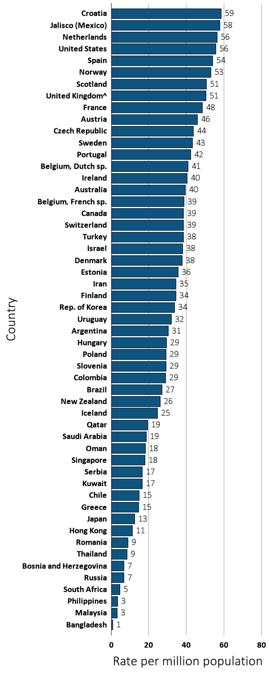
Figure 13.18 Kidney transplantation rate, per million population, by country, 2013
(a) Per million population
Data source: Special analyses, USRDS ESRD Database. Data presented only for countries from which relevant information was available. All rates are unadjusted. ^United Kingdom: England, Wales, & Northern Ireland (Scotland data reported separately). Data for Belgium do not include patients younger than 20. Data for France include 22 regions. Transplant data for Romania are limited to that available in dialysis center reports and includes only non-preemptive transplants. Data for Spain include all regions. Abbreviations: sp., speaking.

Slide 44
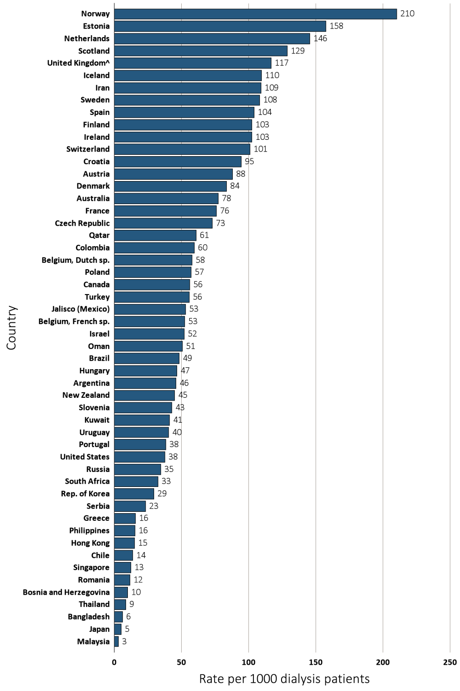
Figure 13.18 Kidney transplantation rate, per 1000 dialysis patients, by country, 2013
(b) Per 1000 dialysis patients
Data source: Special analyses, USRDS ESRD Database. Data presented only for countries from which relevant information was available. All rates are unadjusted. ^United Kingdom: England, Wales, & Northern Ireland (Scotland data reported separately). Data for Belgium do not include patients younger than 20. Data for France include 22 regions. Transplant data for Romania are limited to that available in dialysis center reports, and include only non-preemptive transplants. Data for Spain include all regions. Abbreviations: sp., speaking.

Slide 45
Table 13.7 Kidney transplantation rates, per million population,
by country 2000-2013
Country | 2000 | 2001 | 2002 | 2003 | 2004 | 2005 | 2006 | 2007 | 2008 | 2009 | 2010 | 2011 | 2012 | 2013 | % change from 2000/01 to 2012/13
Argentina | . | . | . | . | . | 19.1 | 21.7 | 23.0 | 25.1 | 26.4 | 27.9 | 28.3 | 30.3 | 30.5 | .
Australia | 27.7 | 27.9 | 30.8 | 27.3 | 32.3 | 30.6 | 31.0 | 29.3 | 38.5 | 35.7 | 38.8 | 38.1 | 37.7 | 39.5 | 38.8
Austria | 43.6 | 48.2 | 45.1 | 43.6 | 43.6 | 45.9 | 47.9 | 43.7 | 39.5 | 47.4 | 44.6 | 45.0 | 47.3 | 45.9 | 1.5
Bahrain | . | . | . | . | . | . | . | . | 10.8 | 18.7 | 11.3 | 6.7 | . | . | .
Bangladesh | 0.4 | 0.2 | 0.4 | 0.4 | 0.4 | 0.4 | 0.2 | 0.5 | 0.5 | 0.6 | 0.6 | 0.8 | 0.5 | 0.7 | 100
Belgium, Dutch sp. | 50.8 | 36.7 | 31.1 | 37.3 | 31.3 | 28.4 | 39.7 | 43.3 | 40.3 | 39.6 | 38.7 | 41.2 | 44.6 | 41.0 | -2.2
Belgium, French sp. | . | 29.4 | 32.2 | 36.5 | 29.8 | 37.6 | 39.3 | 40.8 | 37.4 | 37.9 | 37.0 | 43.1 | 40.6 | 38.7 | 34.9
Bosnia and Herzegovina | . | . | . | 6.5 | 7.6 | 11.5 | 6.8 | 8.4 | 9.1 | 7.0 | 6.0 | 4.6 | 6.8 | 6.8 | .
Brazil | . | . | . | 17.9 | 18.8 | 18.4 | 17.8 | 18.5 | 20.1 | 22.1 | 23.8 | 25.2 | 27.2 | 27.0 | .
Canada | 37.9 | 35.4 | 34.6 | 33.4 | 32.1 | 32.7 | 38.4 | 39.5 | 38.3 | 37.7 | 38.0 | 37.7 | 38.4 | 38.6 | 5
Chile | 17.9 | 17.3 | 16.6 | 19.8 | 16.9 | 17.2 | 18.5 | 17.1 | 16.8 | 15.1 | 13.5 | 15.6 | 16.7 | 14.9 | -10.2
Colombia | 21.7 | 22.7 | 19.7 | 19.2 | 11.0 | 11.9 | 29.8 | 29.5 | 16.1 | 18.9 | 38.9 | 34.9 | 33.3 | 29.0 | 40.3
Croatia | 9.0 | 16.2 | 18.3 | 18.0 | 26.4 | 22.3 | . | . | . | . | . | . | 54.3 | 58.6 | 348
Czech Republic | 33.2 | 30.6 | 32.5 | 40.4 | 41.6 | 38.0 | 41.6 | 38.0 | 31.9 | 34.0 | 27.2 | 31.6 | . | 43.8 | 37.3
Denmark | 28.7 | 30.4 | 31.8 | 32.7 | 34.8 | 32.7 | 30.8 | 31.4 | 34.9 | 40.7 | 41.2 | 44.6 | 37.9 | 37.7 | 27.9
Estonia | . | . | . | . | . | . | . | . | . | . | . | . | . | 35.7 | .
Finland | 37.7 | 32.4 | 32.9 | 31.3 | 37.1 | 31.8 | 39.7 | 32.3 | 28.0 | 33.2 | 32.8 | 33.0 | 36.4 | 34.4 | 1
France | . | . | . | . | . | 36.6 | 39.9 | 45.1 | 44.9 | 44.6 | 45.5 | 46.3 | 47.0 | 48.4 | .
Greece | 12.5 | 16.9 | 20.0 | 21.7 | 19.1 | 23.7 | 22.2 | 21.9 | 24.0 | 15.1 | 11.1 | 17.9 | 17.0 | 14.7 | 7.8
Hong Kong | . | . | 12.0 | 7.5 | 7.4 | 8.6 | 9.6 | 9.5 | 11.0 | 14.0 | 11.7 | 9.3 | 13.8 | 11.3 | .
Hungary | . | . | . | . | . | . | . | . | 25.7 | 27.1 | 30.7 | 25.1 | 27.8 | 29.4 | .
Iceland | 24.9 | 17.5 | 0.0 | 3.5 | 10.3 | 33.7 | 26.3 | 22.5 | 25.2 | 31.4 | 31.4 | 50.2 | 18.7 | 24.7 | 2.4
Iran | . | . | . | . | . | . | . | . | 26.7 | 29.3 | 30.1 | 30.3 | 31.8 | 34.5 | .
Ireland | . | . | . | . | . | . | . | . | . | 37.9 | 26.8 | 42.0 | 35.8 | 40.3 | .
Israel | 29.5 | 24.9 | 23.9 | 36.8 | 37.0 | 43.4 | 43.2 | 37.7 | 33.1 | 28.6 | 23.7 | 36.7 | 19.5 | 38.1 | 5.9
Jalisco (Mexico) | 50.6 | 49.3 | 44.5 | 46.6 | 56.5 | 55.7 | 52.2 | 59.3 | 54.3 | 58.1 | 60.1 | 62.2 | 58.7 | 57.7 | 16.5
Japan | . | . | . | . | . | . | . | . | . | 10.3 | 11.7 | 12.5 | 12.6 | 12.5 | .
Rep. of Korea | 14.2 | 17.6 | 15.2 | 16.5 | 17.4 | 15.5 | 18.8 | 18.5 | 22.7 | 24.5 | 25.1 | 31.7 | 34.4 | 33.8 | 114.5
Kuwait | . | . | . | . | . | . | . | . | . | . | . | . | 18.3 | 16.6 | .
Lebanon | . | . | . | . | . | . | . | . | . | . | . | . | 19.0 | . | .
Malaysia | 6.1 | 6.6 | 6.7 | 6.4 | 7.4 | 6.2 | 11.1 | 8.2 | 4.7 | 5.0 | 4.5 | 4.4 | 3.6 | 3.3 | -45.7
^{(Continue} ^{on the next slide)}

Slide 46
Table 13.7 Kidney transplantation rates, per million population,
by country 2000-2013 (Continued)
Country | 2000 | 2001 | 2002 | 2003 | 2004 | 2005 | 2006 | 2007 | 2008 | 2009 | 2010 | 2011 | 2012 | 2013 | % change from 2000/01 to 2012/13
Morelos (Mexico) | . | . | . | . | . | . | . | 54.6 | 44.5 | 41.8 | . | . | . | . | .
Netherlands | 35.7 | 32.7 | 36.4 | 38.6 | 41.8 | 43.1 | 41.0 | 51.0 | 47.3 | 50.1 | 52.5 | 51.6 | 57.0 | 56.4 | 65.8
New Zealand | 27.5 | 28.3 | 29.7 | 27.7 | 25.7 | 22.5 | 21.5 | 29.1 | 28.6 | 28.1 | 25.3 | 27.4 | 25.0 | 26.1 | -8.4
Norway | 46.1 | 46.7 | 46.9 | 52.8 | 57.7 | 49.5 | 45.5 | 55.2 | 58.3 | 60.5 | 53.8 | 61.0 | 59.6 | 53.0 | 21.3
Oman | . | . | . | . | . | . | . | . | 14.8 | 18.4 | 16.8 | 22.1 | 21.4 | 18.2 | .
Philippines | 3.5 | 3.0 | 3.7 | 4.9 | 5.6 | 7.5 | 7.5 | 11.1 | 7.1 | 5.2 | 4.0 | 3.8 | 3.3 | 3.4 | 3.1
Poland | . | . | . | . | . | . | . | . | 21.2 | 20.6 | 25.9 | 27.0 | 29.7 | 29.3 | .
Portugal | . | . | . | . | . | . | . | . | 49.4 | 55.7 | 54.3 | 50.2 | 40.6 | 42.4 | .
Qatar | . | . | . | . | . | . | . | . | 2.1 | 1.2 | 15.2 | 19.6 | 15.3 | 19.4 | .
Romania | . | . | . | . | . | 4.7 | 5.3 | 2.8 | 7.3 | 6.9 | 6.8 | 9.0 | 7.1 | 8.9 | .
Russia | 3.2 | 3.1 | 3.2 | 2.3 | 2.0 | 2.8 | 2.9 | . | 5.6 | 5.9 | 7.3 | 6.8 | 6.6 | 6.7 | 111.1
Saudi Arabia | . | . | . | . | . | . | . | . | 16.3 | 15.1 | 18.6 | 20.4 | 19.6 | 18.6 | .
Scotland | 36.0 | 31.0 | 29.5 | 30.3 | 26.6 | 29.2 | 26.4 | 37.7 | 41.0 | 40.8 | 35.2 | 37.3 | 43.7 | 50.7 | 40.9
Serbia | . | . | . | . | . | . | . | . | . | . | . | 14.5 | 13.0 | 16.6 | .
Singapore | 16.5 | 21.0 | 14.2 | 10.1 | 17.6 | 19.6 | 24.1 | 23.2 | 20.0 | 18.5 | 16.2 | 17.7 | 13.4 | 17.9 | -16.5
Slovenia | . | . | . | . | . | . | . | . | . | 22.6 | 31.7 | 23.9 | 30.6 | 29.1 | .
South Africa | . | . | . | . | . | . | . | . | . | . | . | . | 4.7 | 4.6 | .
Spain | . | . | . | . | . | . | . | . | . | 49.8 | 47.3 | 52.9 | 54.0 | 54.1 | .
Sweden | 31.9 | 34.8 | 34.6 | 39.0 | 41.7 | 43.2 | 40.5 | 42.3 | 45.6 | 42.4 | 39.5 | 45.2 | 41.3 | 43.2 | 26.7
Switzerland | . | . | . | . | . | . | . | . | . | . | . | . | . | 38.5 | .
Taiwan | 12.0 | 16.0 | 17.2 | . | . | . | . | . | 12.5 | 13.6 | 12.1 | 14.0 | 11.2 | . | -20
Thailand | 3.3 | 3.6 | 4.0 | 5.7 | 4.3 | . | 3.6 | 5.9 | 5.4 | 4.8 | 5.5 | 6.3 | 7.2 | 8.5 | 127.5
Turkey | 5.5 | 6.9 | 7.8 | 7.7 | 9.2 | 4.5 | 11.6 | 18.6 | 18.1 | 26.3 | 34.5 | 39.3 | 38.4 | 38.4 | 519.4
Ukraine | . | . | . | . | . | . | . | . | . | . | . | . | 2.1 | . | .
United Kingdom^ | . | . | . | . | 34.8 | 30.0 | 34.1 | 38.3 | 40.3 | 42.1 | 44.0 | 44.3 | 45.9 | 50.5 | .
United States | 52.3 | 53.9 | 55.2 | 55.8 | 58.1 | 59.1 | 61.6 | 58.1 | 58.1 | 58.5 | 58.0 | 57.0 | 55.4 | 55.7 | 4.6
Uruguay | 17.4 | 15.3 | 27.1 | 20.9 | 31.8 | 35.4 | 42.8 | 28.9 | 37.5 | 35.0 | 25.6 | 39.0 | 25.3 | 32.0 | 75.2
Data source: Special analyses, USRDS ESRD Database. Data presented only for countries from which relevant information was available. Prevalence is unadjusted. ^United Kingdom: England, Wales, & Northern Ireland (Scotland data reported separately). Data for France include 15 regions in 2006, 18 in 2007, 20 in 2008, and 22 in 2009-2013. Data for Belgium do not include patients younger than 20. There is underreporting of prevalent transplant patients in Turkey . ª% change is calculated as the percent difference between the average prevalence in 2012 and 2013 and the average in 2000 and 2001. Abbreviations: ESRD, end-stage renal disease; sp., speaking; . signifies data not reported.

Slide 47
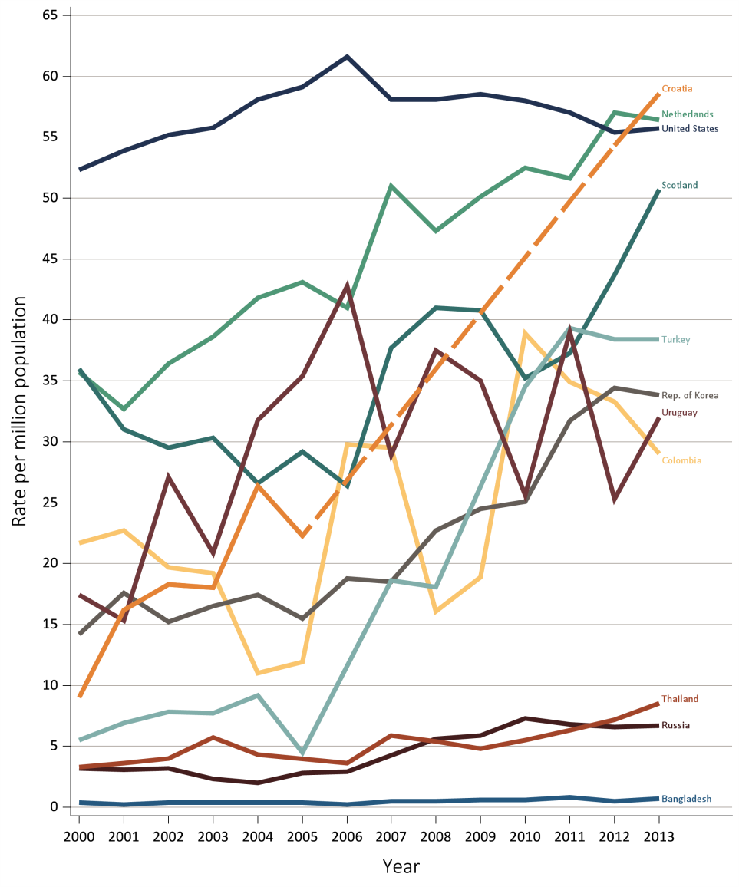
Figure 13.19 Kidney transplantation rate, per million population, by country, 2000-2013
Ten countries having the highest % rise in kidney transplantation rate from 2000/01 to 2012/13, plus the U.S.
Data source: Special analyses, USRDS ESRD Database. All rates are unadjusted. Data for Croatia are missing from 2006-2011, as indicated by the dashed line. Abbreviations: ESRD, end-stage renal disease.

Slide 48
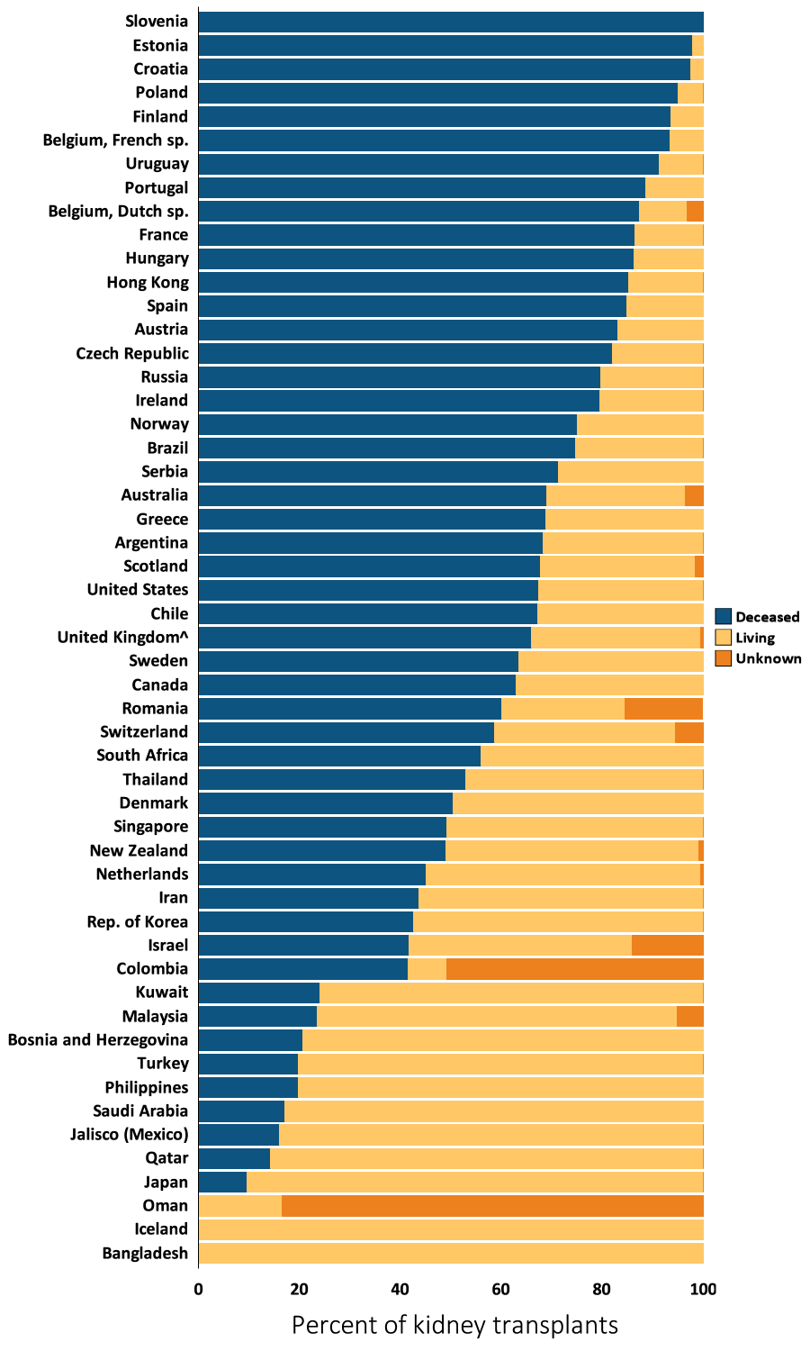
Figure 13.20 Distribution of the percentage of kidney transplantations, by kidney donor type and country, 2013
Data source: Special analyses, USRDS ESRD Database. Denominator is calculated as the sum of deceased, living donor, and unknown transplants. ^United Kingdom: England, Wales, & Northern Ireland (Scotland data reported separately). Data for France include 22 regions. Abbreviations: ESRD, end-stage renal disease.

Slide 49
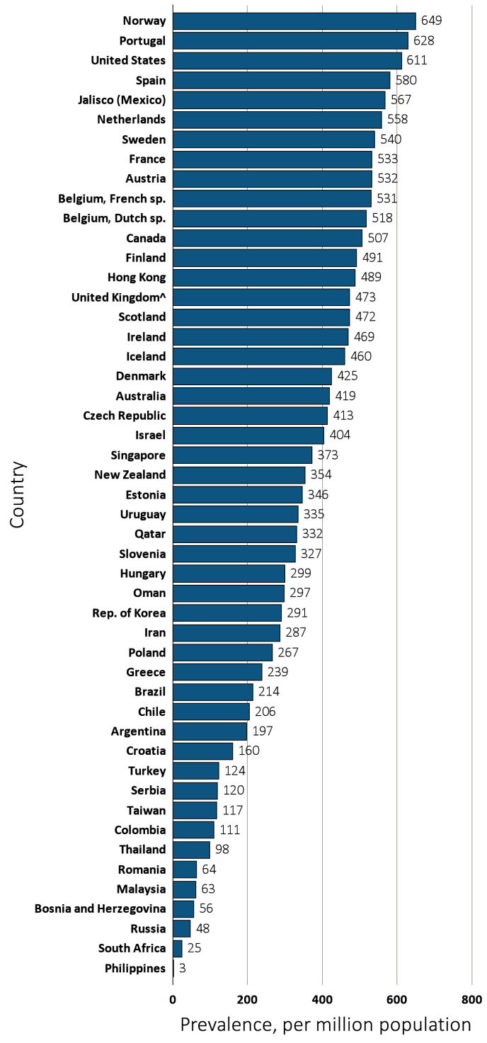
Figure 13.21 Prevalence of treated ESRD patients with a functioning kidney transplant, per million population, by country, 2013
Data source: Special analyses, USRDS ESRD Database. Data presented only for countries from which relevant information was available. Prevalence is unadjusted. Data for France include 22 regions. ^United Kingdom: England, Wales, & Northern Ireland (Scotland data reported separately). Data for Belgium do not include patients younger than 20. Abbreviations: ESRD, end-stage renal disease; sp., speaking.

Slide 50
Table 13.8 Trends in the prevalence of treated ESRD patients with a functioning kidney transplant, per million population, by country, 2000-2013
Country | 2000 | 2001 | 2002 | 2003 | 2004 | 2005 | 2006 | 2007 | 2008 | 2009 | 2010 | 2011 | 2012 | 2013 | % change from 2000/01 to 2012/13
Argentina | . | . | . | . | . | . | . | . | 132.3 | 127.9 | 144.8 | 130.9 | 164.8 | 197.2 | .
Australia | 274.1 | 280.9 | 292.4 | 300.1 | 311.6 | 321.6 | 331.2 | 338.4 | 360.2 | 370.8 | 385.9 | 396.4 | 407.7 | 419.3 | 49
Austria | 342.3 | 369.0 | 387.4 | 447.0 | 412.6 | 428.0 | 438.9 | 455.8 | 460.0 | 474.9 | 484.5 | 497.6 | 515.1 | 532.4 | 47.3
Bahrain | . | . | . | . | . | . | . | . | 62.4 | 57.7 | 53.5 | 52.7 | . | . | .
Bangladesh | 2.6 | 2.7 | 3.1 | 3.3 | 3.2 | 3.4 | 3.5 | . | . | . | . | . | . | . | .
Belgium, Dutch sp. | 349.8 | 366.4 | 377.3 | 391.1 | 400.7 | 404.7 | 423.3 | 439.4 | 451.6 | 464.0 | 474.7 | 489.8 | 506.1 | 517.6 | 42.9
Belgium, French sp. | . | 322.4 | 349.5 | 377.3 | 392.8 | 410.4 | 433.7 | 453.2 | 471.4 | 463.0 | 480.5 | 501.0 | 516.2 | 530.6 | 62.3
Bosnia and Herzegovina | . | . | . | 26.6 | 31.6 | 33.4 | 31.6 | 31.8 | 40.4 | 43.6 | 42.3 | 47.3 | 51.9 | 56.2 | .
Brazil | . | . | . | . | . | . | . | . | . | . | . | 176.8 | 193.2 | 214.4 | .
Canada | 319.7 | 335.0 | 348.4 | 367.7 | 381.0 | 392.9 | 409.2 | 428.1 | 441.7 | 451.4 | 464.9 | 478.1 | 491.6 | 506.8 | 52.5
Chile | 126.9 | 131.3 | 138.7 | 151.6 | 156.2 | 157.5 | 164.8 | 175.4 | 188.9 | 190.8 | 191.5 | 210.1 | 203.4 | 205.6 | 58.4
Colombia | . | . | . | . | . | . | . | . | 60.6 | 59.8 | 88.8 | 88.3 | 99.7 | 111.1 | .
Croatia | 91.8 | 100.1 | 117.9 | 134.3 | 153.8 | 166.3 | . | . | . | . | . | . | 381.3 | 159.9 | 182
Czech Republic | 238.4 | 252.7 | 266.7 | 276.3 | 316.9 | . | . | . | . | 358.9 | 370.3 | 390.3 | . | 412.5 | 68
Denmark | 253.8 | 261.6 | 273.3 | 288.4 | 297.4 | 266.8 | 318.0 | 333.6 | 341.6 | 355.1 | 375.8 | 395.0 | 409.8 | 424.6 | 61.9
Estonia | . | . | . | . | . | . | . | . | . | . | . | . | . | 346.0 | .
Finland | 352.0 | 369.5 | 378.2 | 391.3 | 408.6 | 418.0 | 434.5 | 445.5 | 449.4 | 460.2 | 469.3 | 476.0 | 483.9 | 490.9 | 35.1
France | . | . | . | . | . | 390.0 | 408.6 | 407.3 | 425.7 | 464.4 | 483.2 | 500.5 | 514.6 | 532.6 | .
Greece | 139.9 | 141.5 | 150.8 | 161.9 | 170.3 | 181.6 | 192.5 | 202.3 | 214.8 | 218.2 | 216.1 | 221.8 | 231.7 | 239.0 | 67.3
Hong Kong | . | . | 312.5 | 314.4 | 361.4 | 387.4 | 409.7 | 420.4 | 442.8 | 481.7 | 484.2 | 477.7 | 485.4 | 488.5 | .
Hungary | . | . | . | . | . | . | . | . | . | 263.3 | 269.9 | 278.5 | 287.0 | 299.1 | .
Iceland | 224.0 | 231.6 | 236.5 | 241.8 | 246.5 | 276.3 | 316.0 | 318.8 | 321.3 | 345.4 | 371.0 | 410.6 | 439.6 | 460.2 | 97.5
Iran | . | . | . | . | . | . | . | . | 245.7 | 242.2 | 253.7 | 265.0 | 276.0 | 286.9 | .
Ireland | . | . | . | . | . | . | . | . | . | 402.3 | 415.2 | 438.7 | 453.4 | 469.4 | .
Israel | . | . | . | 297.2 | 312.8 | 336.8 | 357.5 | 372.1 | 386.0 | 382.9 | 380.7 | 391.9 | 395.2 | 404.1 | .
Jalisco (Mexico) | . | . | . | . | . | 314.7 | 352.0 | 399.4 | 436.2 | 458.2 | 460.2 | 500.4 | 525.8 | 567.4 | .
Japan | . | . | . | . | . | . | . | . | . | 85.0 | 83.3 | . | . | . | .
Rep. of Korea | 156.8 | 164.8 | 170.5 | 176.9 | 183.2 | 188.2 | 195.7 | 202.2 | 212.8 | 224.8 | 234.1 | 252.4 | 272.3 | 290.5 | 75
Malaysia | 53.0 | 55.4 | 58.1 | 60.1 | 62.4 | 64.4 | 65.6 | 65.3 | 65.6 | 65.4 | 66.4 | 65.8 | 64.5 | 62.9 | 17.5
^{(Continue} ^{on the next slide)}

Slide 51
Table 13.8 Trends in the prevalence of treated ESRD patients with a functioning kidney transplant, per million population, by country, 2000-2013 (Continued)
Country | 2000 | 2001 | 2002 | 2003 | 2004 | 2005 | 2006 | 2007 | 2008 | 2009 | 2010 | 2011 | 2012 | 2013 | % change from 2000/01 to 2012/13
Morelos (Mexico) | . | . | . | . | . | . | . | 41.9 | 34.3 | 31.6 | . | . | . | . | .
Netherlands | 314.6 | 325.9 | 341.0 | 357.6 | 376.7 | 396.9 | 418.9 | 446.1 | 450.5 | 465.1 | 487.9 | 508.8 | 532.9 | 558.2 | 70.4
New Zealand | 264.6 | 273.9 | 283.1 | 291.3 | 298.7 | 299.7 | 298.0 | 303.4 | 317.6 | 327.0 | 331.9 | 339.0 | 345.1 | 353.9 | 29.8
Norway | 437.5 | 451.7 | 466.0 | 488.5 | 513.3 | 524.5 | 536.6 | 551.7 | 573.2 | 592.1 | 609.3 | 628.9 | 639.0 | 648.7 | 44.8
Oman | . | . | . | . | . | . | . | . | 232.5 | 241.4 | 296.5 | 315.4 | 331.1 | 297.4 | .
Philippines | . | . | 2.2 | . | . | 4.6 | 4.8 | 5.3 | 5.2 | 5.2 | 4.0 | 3.8 | 3.3 | 3.4 | .
Poland | . | . | . | . | . | . | . | . | 240.8 | 210.4 | 208.9 | 240.6 | 249.0 | 266.6 | .
Portugal | . | . | . | . | . | . | . | . | 484.2 | 544.7 | 565.8 | 609.8 | 602.1 | 628.3 | .
Qatar | . | . | . | . | . | . | . | . | 2.1 | 1.2 | 354.5 | 373.4 | 375.5 | 332.4 | .
Romania | . | . | . | . | . | 14.9 | 19.7 | 22.0 | 28.6 | 37.5 | 44.0 | 51.9 | 57.9 | 64.1 | .
Russia | 16.5 | 18.1 | 18.7 | 21.9 | 23.1 | 24.5 | 28.5 | . | 33.7 | 37.7 | 41.2 | 41.6 | 43.4 | 47.8 | 163.6
Saudi Arabia | . | . | . | . | . | . | . | . | 336.8 | 318.2 | 298.4 | 273.0 | 252.0 | . | .
Scotland | 307.6 | 326.4 | 329.6 | 345.4 | 351.3 | 361.2 | 369.0 | 386.5 | 394.7 | 408.9 | 417.8 | 430.6 | 448.7 | 471.9 | 45.2
Serbia | . | . | . | . | . | . | . | . | . | . | . | 107.3 | 111.1 | 120.4 | .
Singapore | 261.2 | 279.0 | 280.8 | 292.0 | 303.8 | 317.2 | 329.6 | 340.8 | 348.9 | 353.3 | 360.0 | 370.0 | 367.8 | 373.0 | 37.1
Slovenia | . | . | . | . | . | . | . | . | . | 265.2 | 283.6 | 296.2 | 310.1 | 327.2 | .
South Africa | . | . | . | . | . | . | . | . | . | . | . | . | 30.7 | 24.7 | .
Spain | . | . | . | . | 521.6 | 386.3 | 445.4 | 452.7 | 505.0 | 424.7 | 516.1 | 537.6 | 545.9 | 579.9 | .
Sweden | 377.5 | 386.7 | 396.8 | 411.2 | 430.4 | 438.9 | 454.5 | 469.5 | 487.1 | 498.8 | 506.8 | 519.4 | 529.0 | 539.5 | 39.8
Taiwan | . | . | . | . | . | . | . | . | . | 82.2 | 91.0 | 100.0 | 107.7 | 117.2 | .
Thailand | . | 15.9 | 23.8 | 33.8 | 24.9 | 24.7 | 20.5 | 57.4 | 36.3 | 46.0 | 49.8 | 56.0 | 88.9 | 98.4 | 489
Turkey | 21.0 | 26.7 | 36.6 | 41.1 | 47.1 | 20.7 | 58.4 | 80.0 | 109.4 | 101.6 | 104.4 | 95.4 | 105.8 | 123.9 | 381.6
Ukraine | . | . | . | . | . | . | . | . | . | . | . | . | 2.1 | . | .
United Kingdom^ | . | . | . | . | 286.3 | 271.3 | 287.5 | 345.8 | 370.4 | 386.7 | 406.9 | 425.0 | 443.8 | 472.8 | .
United States | 378.4 | 397.1 | 416.7 | 435.7 | 456.2 | 476.5 | 497.2 | 516.1 | 533.7 | 550.7 | 567.2 | 583.1 | 597.1 | 611.3 | 55.8
Uruguay | 87.5 | 100.8 | 120.1 | 134.3 | 151.5 | 131.9 | 210.3 | 234.7 | 255.5 | 272.7 | 284.2 | 312.9 | 315.6 | 335.3 | 245.7
Data source: Special analyses, USRDS ESRD Database. Data presented only for countries from which relevant information was available. Prevalence is unadjusted. ^United Kingdom: England, Wales, & Northern Ireland (Scotland data reported separately). Data for France include 15 regions in 2006, 18 in 2007, 20 in 2008, and 22 in 2009-2013. Data for Belgium do not include patients younger than 20. There is underreporting of prevalent transplant patients in Turkey . ª% change is calculated as the percent difference between the average prevalence in 2012 and 2013 and the average in 2000 and 2001. Abbreviations: ESRD, end-stage renal disease; sp., speaking; . signifies data not reported.

